Slide 1
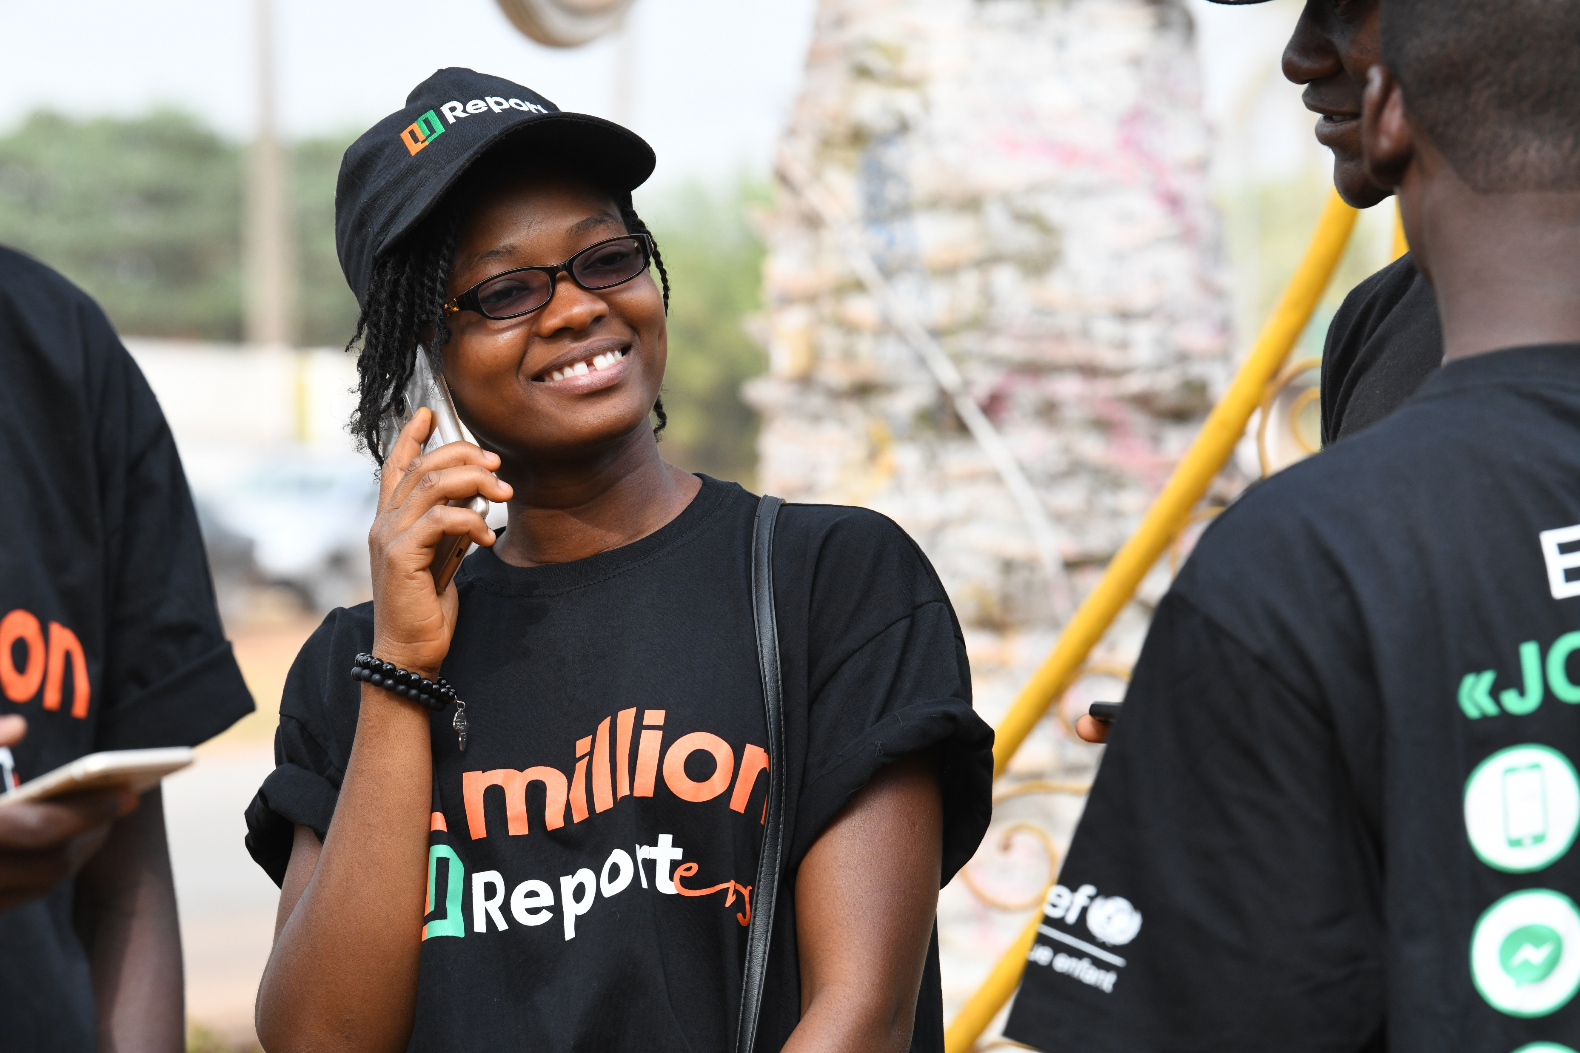
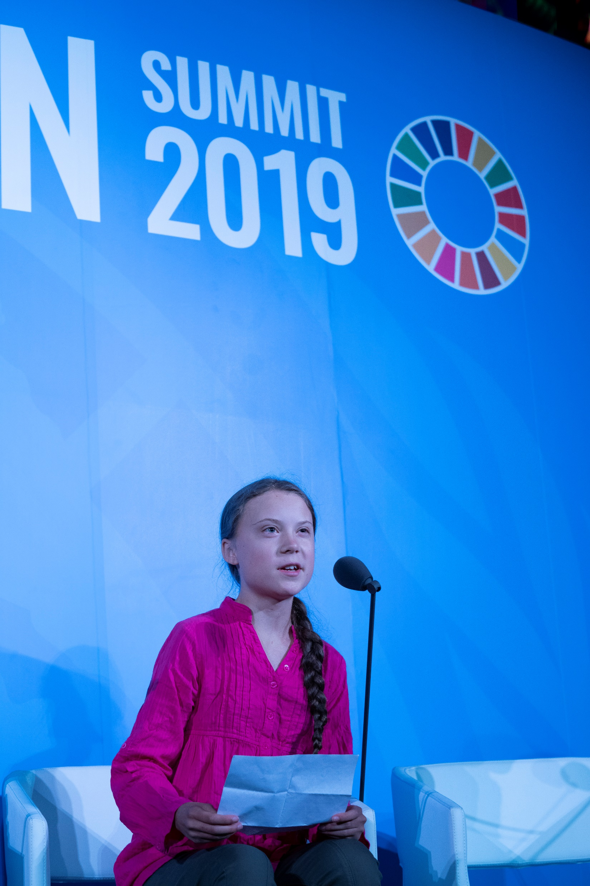
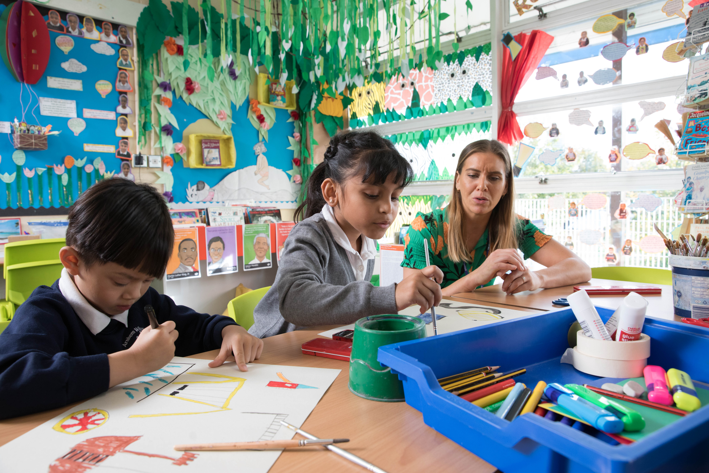
Guess the article
These pictures provide a clue to this week’s article.
How do these pictures help you? Can you guess how they are linked together?
Write down your thoughts or discuss with someone in your house.
UNICEF/Dejongh
UNICEF/Pak
UNICEF/Dawe

Slide 2

Introducing… Article 12
Martin introduces Article 12 – Respect for the views of the child
Every child has the right to express their views, feelings and wishes in all matters affecting them, and to have their views considered and taken seriously.
This right applies at all times, for example during immigration proceedings, housing decisions or the child’s day-to-day home life.

