Slide 1
What do you need to be heard?
What sort of things need to happen if you are to get your voice heard properly?
What would help you? What should adults do?
Write them down and then compare your answers with the next slide.

Slide 2
How many of these did you get?
Being properly listened to
Information about the situation so that you can comment properly
Help to communicate your ideas if you need it
An invitation or opportunity to give your views in a way that works for you
Feed-back so that you know your views have been heard
Feeling that your voice counts
Trusting that you can speak honestly even if your opinion is different from many others
Believing that your opinion is welcome and respected

Slide 3


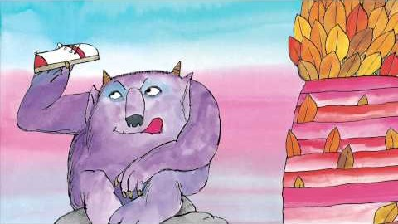


Activity Time
In some stories children’s views are ignored. Have you read ‘Not Now Bernard!’? If not watch this story. What would you say to Bernard’s parents if you had the chance?
All these activities are related to…
Can you think of any stories or films in which children’s voices are really listened to and it makes a difference? If you think of one, tell somebody about it.
Write to your headteacher or your School Council with your ideas about the learning activities being set for you. Explain the things you find helpful and suggest things you might like to do differently.
Design a poster for display
about the importance of
Article 12.
You don’t need to do every single activity
but if you have time you can do more than one.
Primary

Slide 4


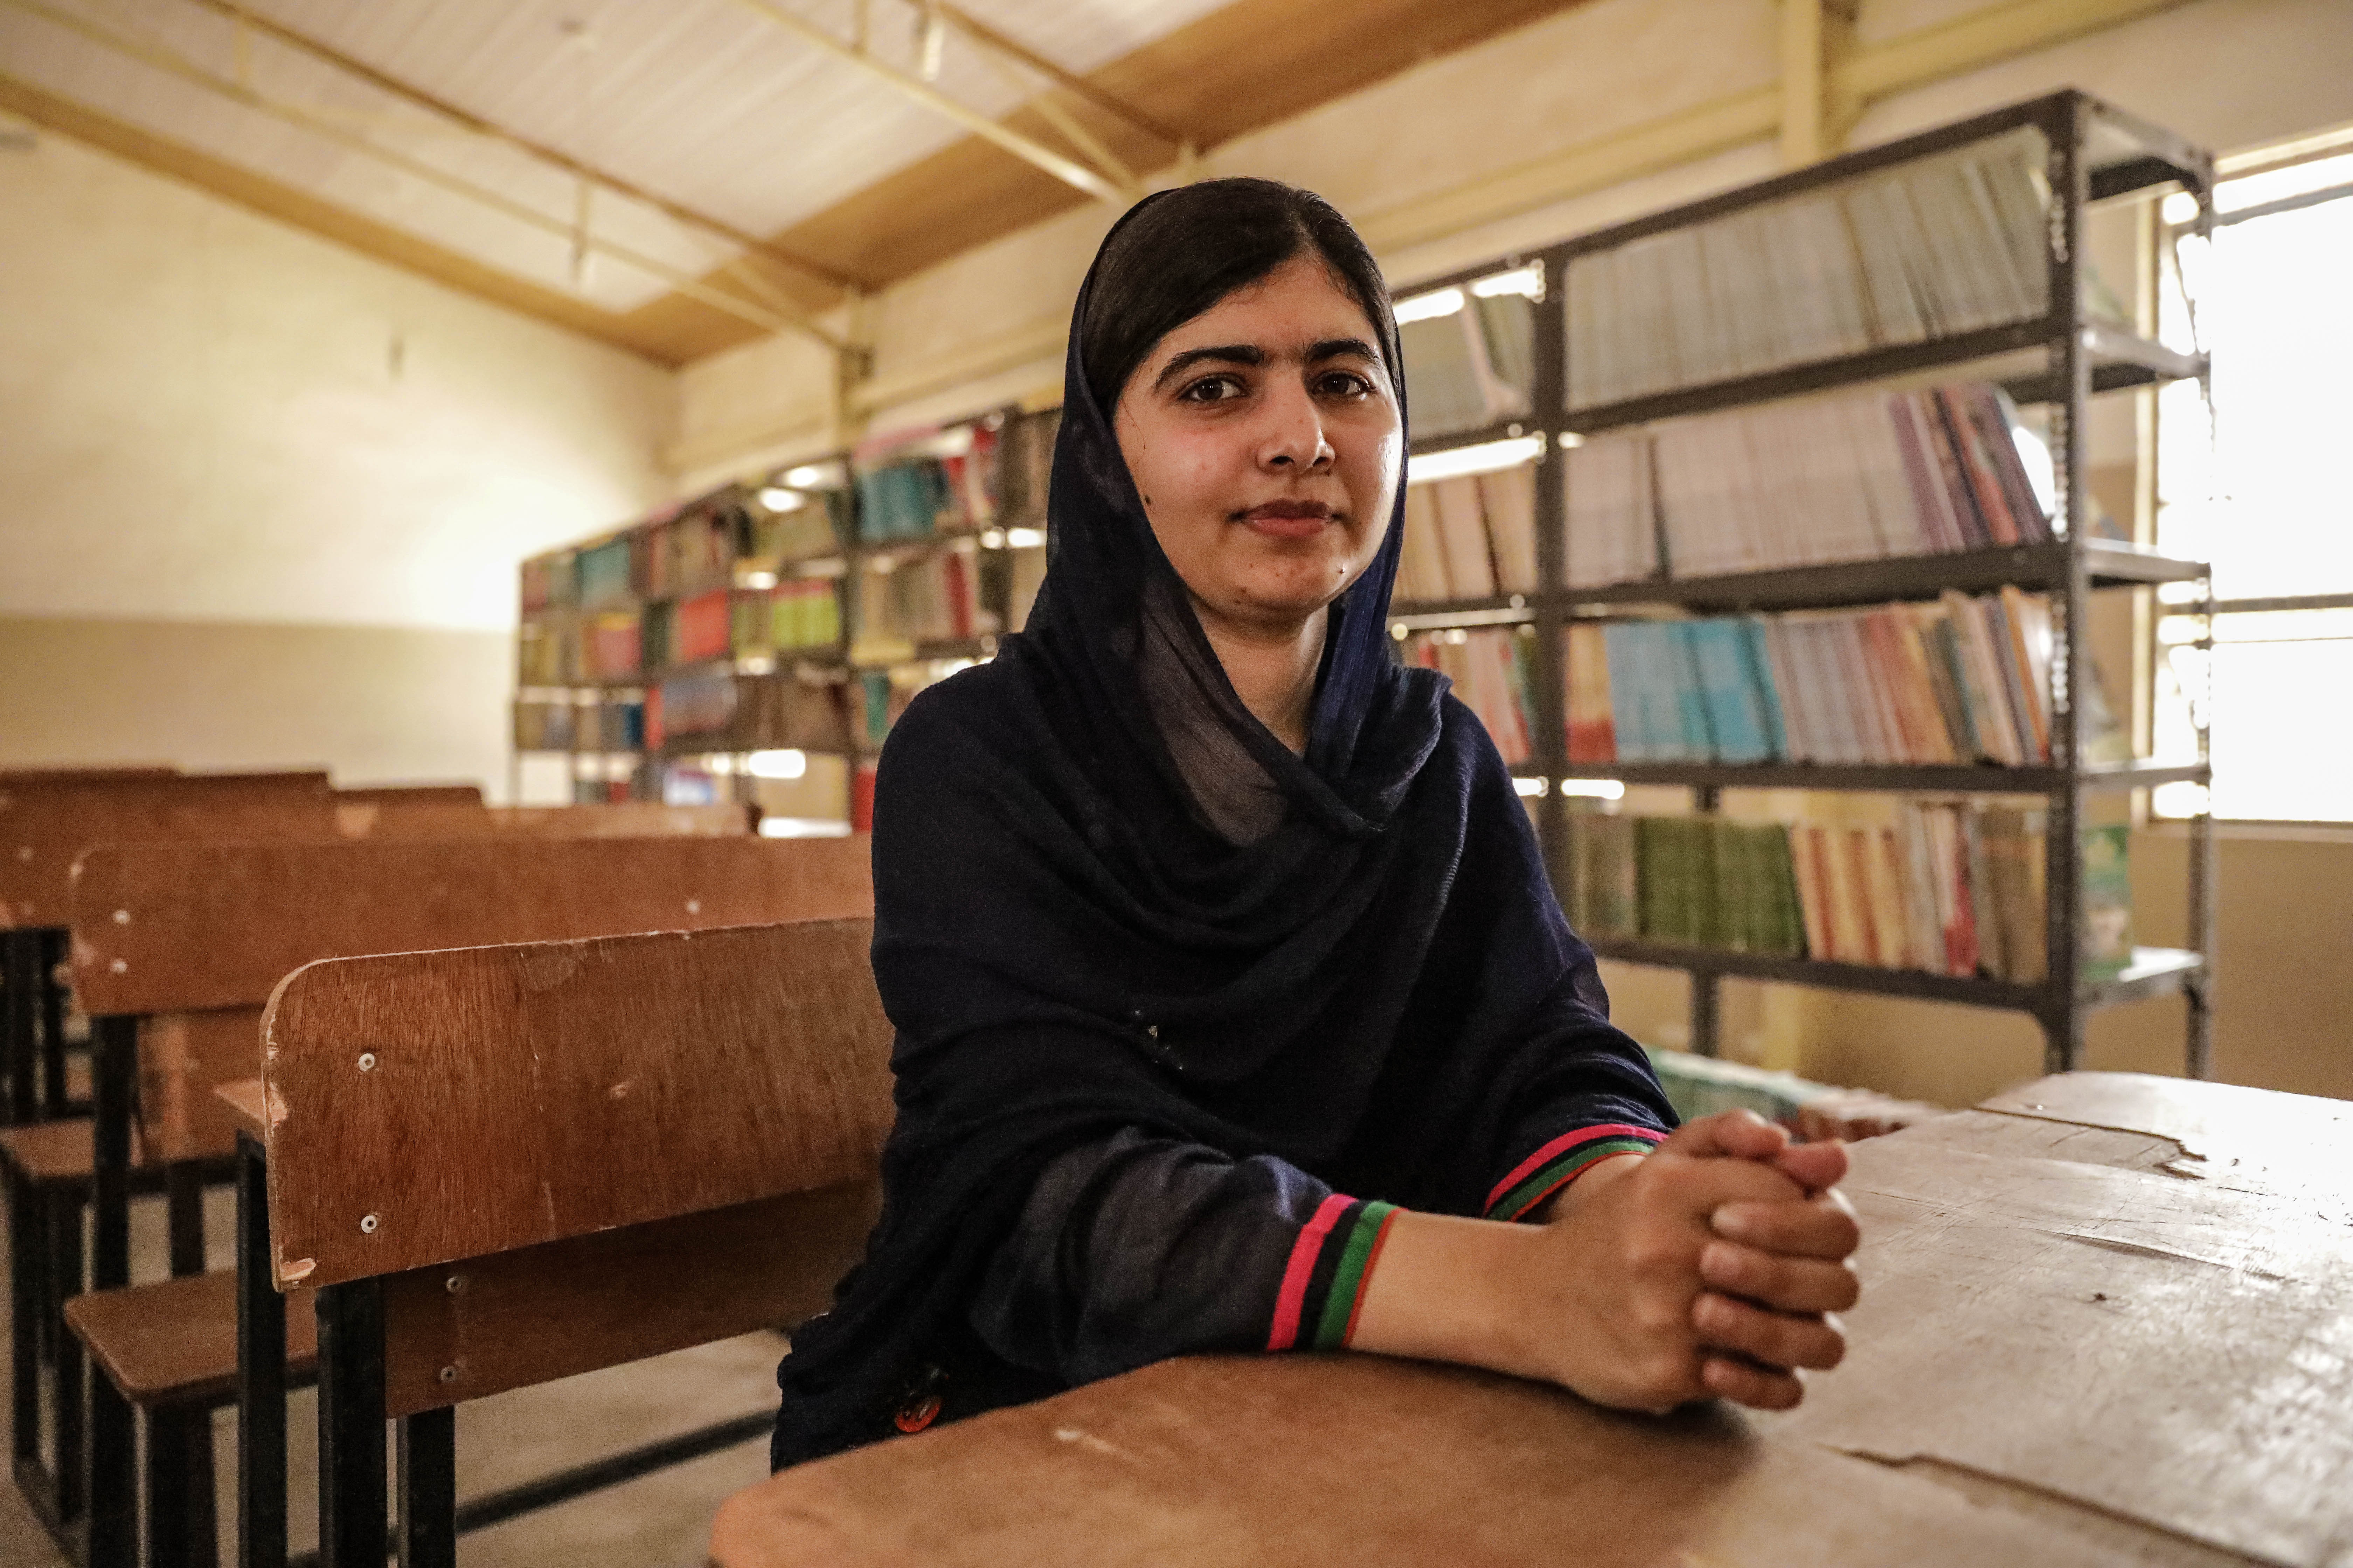
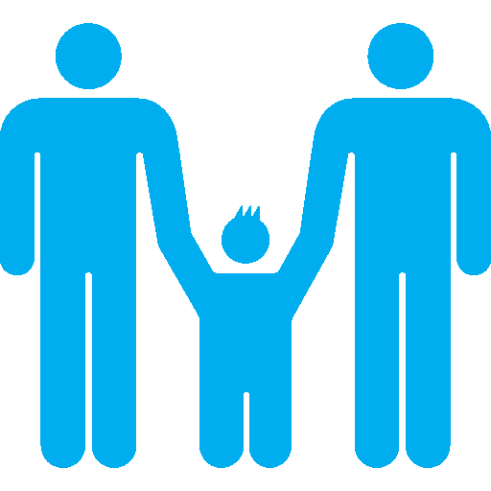
Activity Time
Find out about a child or young person who made sure their voice was heard. You could choose Malala Yousafzai or Greta Thunberg or see if you can find out about somebody less well known.
Write a creative story, a poem, a short play script or a piece of art using the title ‘Head My Voice’. Share it with your teacher and class.
.
Have you ever thanked people at home who are good at listening to you? Design a card or picture, or write a letter to thank them for hearing your voice.
Are you familiar with organisations such as Childline and YoungMinds which support young people to express their views, concerns and worries. If not, spend a while exploring their website, you might find some of the guidance interesting or helpful. Think about sharing this information with your friends.
UNICEF/Abubakar
Primary

Slide 5


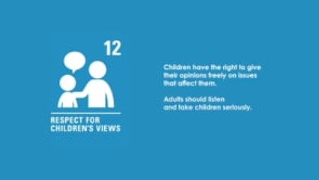

Activity time
Find out how your school is listening to students’ opinions and views during this time of school closure.
This short film was made by a Scottish charity called ‘Families Outside’. It helps explain why Article 12 is important. Watch now.
These activities will help you understand how...
…can relate to your life. You don’t need to do every activity, just do as many as you can.
If you were to stand for election to your School Council or Pupil Parliament next year what would you say in your speech or manifesto? Start drafting it now!
After you have watched the short film write down three reasons why children's opinions should be taken seriously by adults.
Secondary

Slide 6
Extension activity
Article 12 is one of four General Principles of the Convention (the others being Articles 2, 3 and 6)
All rights are equally important but these four Articles have a special role to play. This is because, as well as having full meaning on their own, they all apply to each of the other rights in the Convention too. So, for example, if you look at the right to relax and play, the views of the child should have a role.
Have a look at a variety of rights and ask yourself how does Article 12 apply to or add to our understanding of each right.
You can find a summary of the whole Convention here
UNICEF/Dawe

