Slide 1

Online Safety
Mr Cox and Mr Pugh

Slide 2
Welcome

Slide 3
Aims of Today
We are going to look at the following areas:
Gaming
Age Limits
Time Limits
Monitoring systems at school
Monitoring systems at home

Slide 4
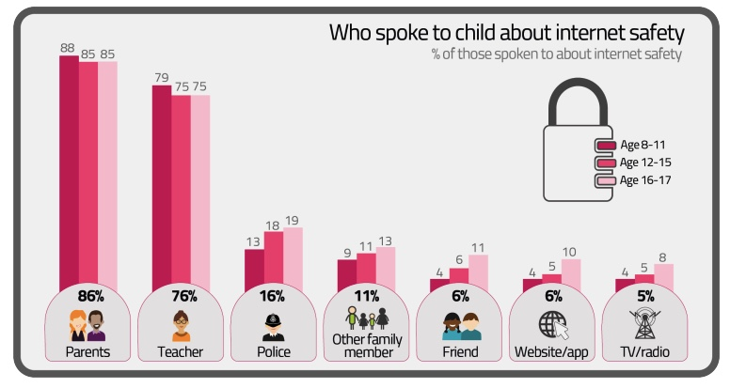

Slide 5
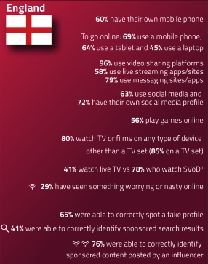


Slide 6
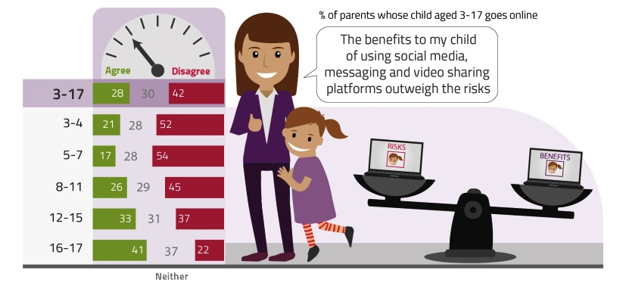

Slide 7
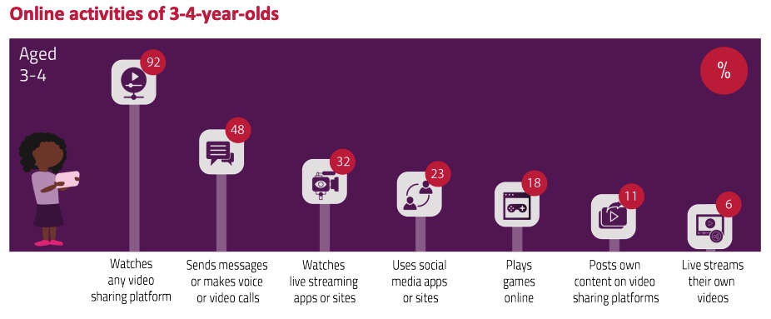

Slide 8
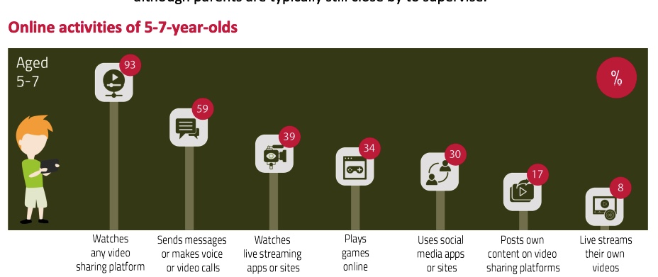

Slide 9
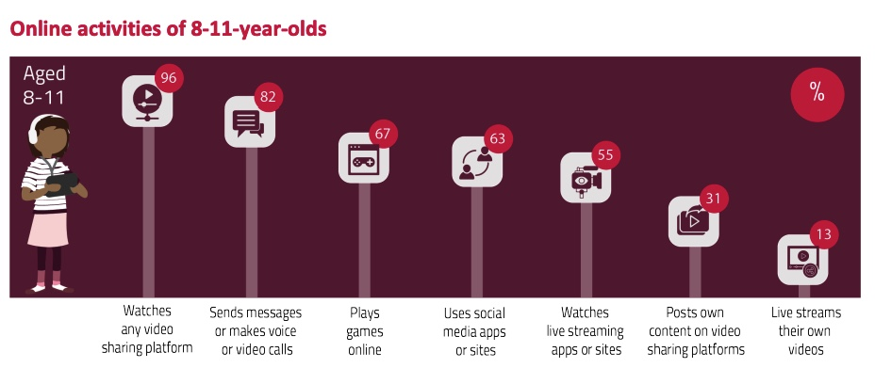

Slide 10
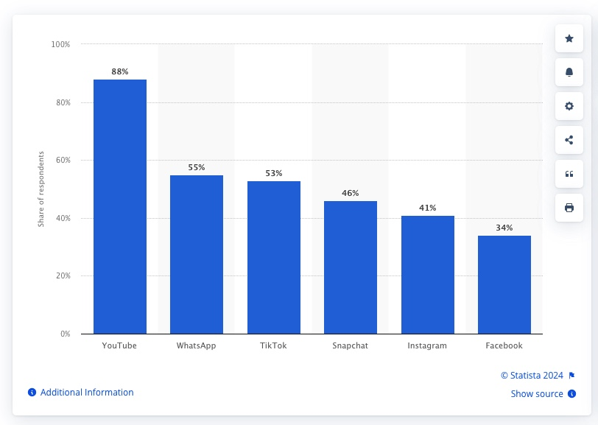
Despite YouTube’s popularity, downloads of the YouTube Kids app have experienced a decrease recently, going from 1.99 million downloads in 2020 to approximately 1.5 million downloads in 2022.
Two in three (64%) children aged 3-17 used apps for social media53, while a third (32%) used apps or sites to post videos they had made, and 15% live-streamed their own content.

Slide 11
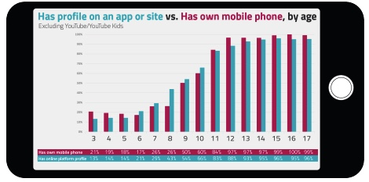

Slide 12

Gaming
What games do your children play at home?
Do you know their age rating?
What do you know about these games?

Slide 13

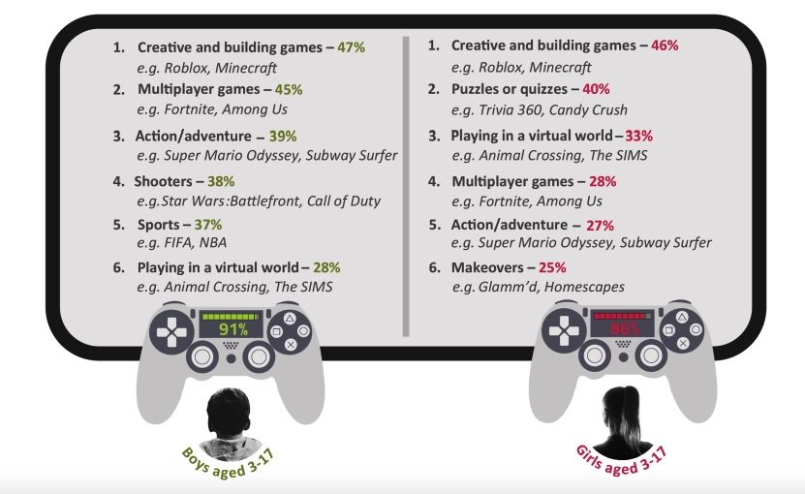

Gaming
56% of 3-17 years old play games online (2022)
Seven in 10 UK kids reporting to use Roblox on their smartphones.

Slide 14

Age limits

Slide 15



Guess the Age Rating
Can you guess the correct age rating of these apps?
Click the boxes to reveal the answers!
Why is it this rating?
Violence and fear

Slide 16

Guess the Age Rating
Can you guess the correct age rating of these apps?
Click the boxes to reveal the answers!
Why is it this rating?
Violence, fear and in-game purchases.

Slide 17

Guess the Age Rating
Can you guess the correct age rating of these apps?
Click the boxes to reveal the answers!

Slide 18


Guess the Age Rating
Can you guess the correct age rating of these apps?
Click the boxes to reveal the answers!
Why is it this rating?
Violence

Slide 19


Guess the Age Rating
Can you guess the correct age rating of these apps?
Click the boxes to reveal the answers!
Why is it this rating?
Violence, bad language and in-game purchases

Slide 20


Guess the Age Rating
Can you guess the correct age rating of these apps?
Click the boxes to reveal the answers!

Slide 21






Guess the Age Rating
Can you guess the correct age rating of these apps?
Click the boxes to reveal the answers!
13
13
13
16
18
13

Slide 22
Time limits
Average screen time by age
So how much time do kids spend looking at a screen? It varies by age, and it’s increased since the pandemic started. Listed below are average daily screen times by age group:
Average screen time for kids ages 0 to 2 – 49 minutes a day
Average screen time for kids ages 2 to 4 – 2 to 2.5 hours a day
Average screen time for kids ages 5 to 8 – Over 3 hours a day
Average screen time for tweens ages 8 to 12 – Almost 5 hours a day
Average screen time for teens – Almost 7.5 hours a day
These estimates include time spent on entertainment like apps, video games, TV and movies, but do not include screen time spent doing homework or other educational activities. As these are averages, many children in today's world exceed these estimates.

Slide 23
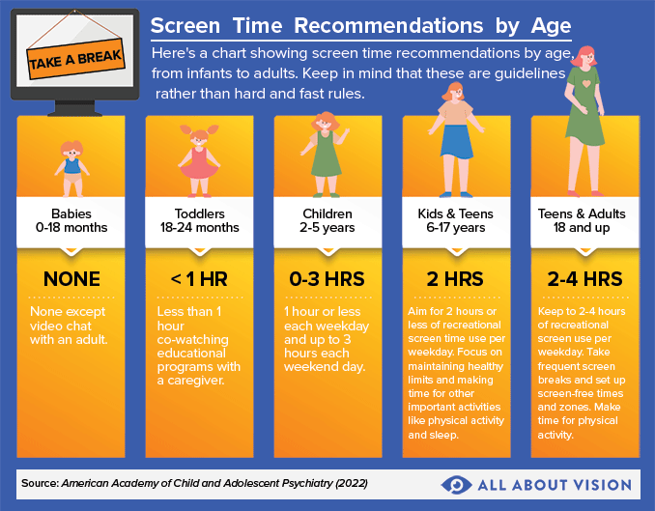

Slide 24
Monitoring Systems
As of November 2022, 55 percent of parents of boys and 57 percent of parents of girls were aware of the possibility of asking their mobile phone networks to block access to adult or inappropriate content.
Over two in 10 parents of kids aged between eight and 11 used parental control apps, but only about one in 10 parents of kids between three and 17 years of age reported doing the same.

Slide 25
What can help?
What to do next these are some things that can make a difference:
1. Think about how you guide your family in the real world and how you can do the same in the digital world.
2. Question your own behaviour and what we, as adults, are modelling.
3. Try out the technologies your child enjoys - download some of their music and have a go at games they like. Look at the latest social media trends they are talking about.. Download the apps and see how they work, or google a guide to it.
4. Talk to your own friends and family about how they manage their children’s digital lives. Use some of the resources to make sure you can guide on privacy settings and age restrictions.
5. Bear in mind that policing is not equipping young people with skills for life – guidance and education are essential.
6. Remind older siblings that websites they use may not be suitable for younger brothers and sisters. Be aware of PEGI game ratings – 18 is usually 18 for a good reason.
7. Make digital issues part of ordinary, everyday conversations - talking about subjects like cyberbullying, sexting and gaming and help them understand the consequences.
8. When you’re talking about bullying, sex and relationships and other issues, don’t forget to include the online aspects.
9. Talk together about ‘friends’. Agree what a true friend is, and discuss the problems with people who ask to be your ‘friend’ online.
10. Talk to your children about whether the issues they face are different online and offline.
11. Don’t be afraid to set boundaries and rules
12. Talk to your child about their online reputation and how content (their digital footprint) could remain for years.
13. If your child does tell you about something, try not to over react as it will discourage them from turning to you again. Remember, they often do not want to see some of the content they might stumble across.
14. There are fantastic resources for parents and carers. Once a month or so, check out the websites in the resources list on the next pages. They will give you up-to-date information about the latest online trends.

