Slide 2
Aim
To learn about how celebrating Diwali brings Sikhs and Hindus together.
Learning Outcomes
I know how Diwali is celebrated by both Sikhs and Hindus around the world.
I understand why Diwali is celebrated.

Slide 3
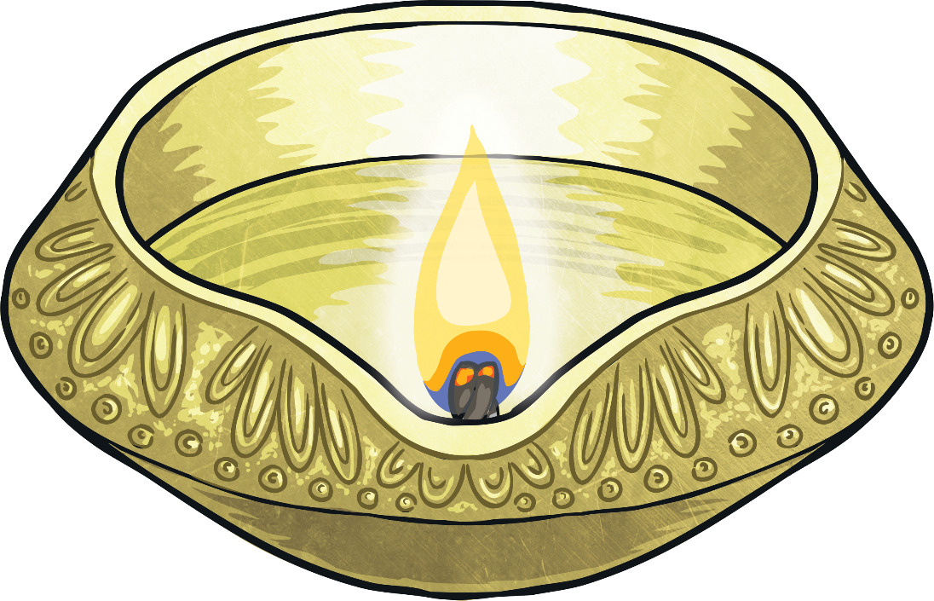
Start Activity
Write down what you already know about Diwali.

Slide 4
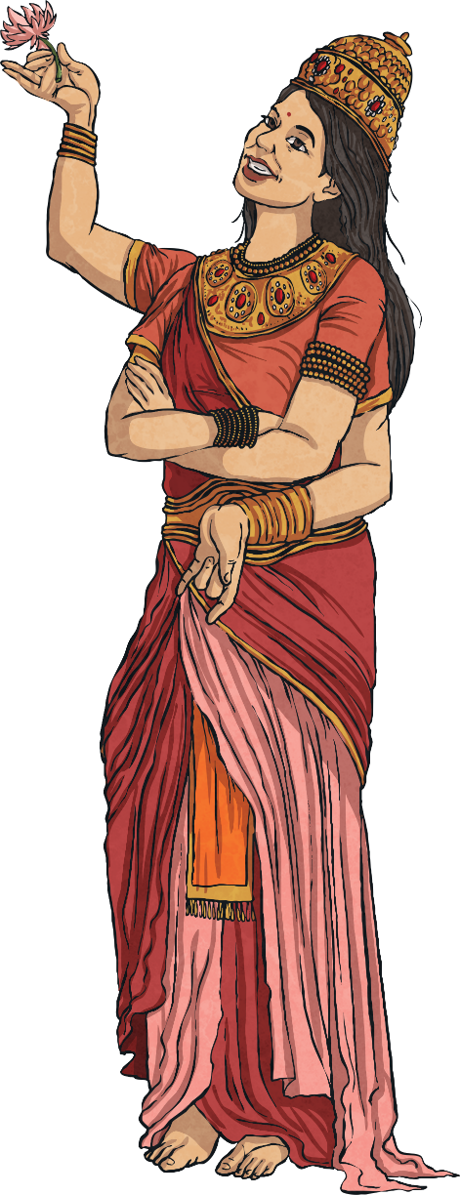
Diwali for Hindus
Diwali, the Hindu festival of lights, is a very popular festival celebrated in South Asia.
The festival of Diwali takes place over five days and is greatly enjoyed by children because of the lights, fireworks and sweets involved. Oil lamps are lit to help the goddess of wealth and success, Lakshmi, find her way into people's homes.
Diwali celebrates one of the legends which tells of the return of Rama and Sita to Rama's kingdom.
The festival celebrates the victory of good over evil and light over darkness although the legends associated with the festival can vary in different parts of India.
In both Britain and India, the festival is a time for spring cleaning, new clothes and gifts. In India, oil lamps are often floated across the river Ganges - it is regarded as good luck if the lamp travels all the way across.

Slide 5
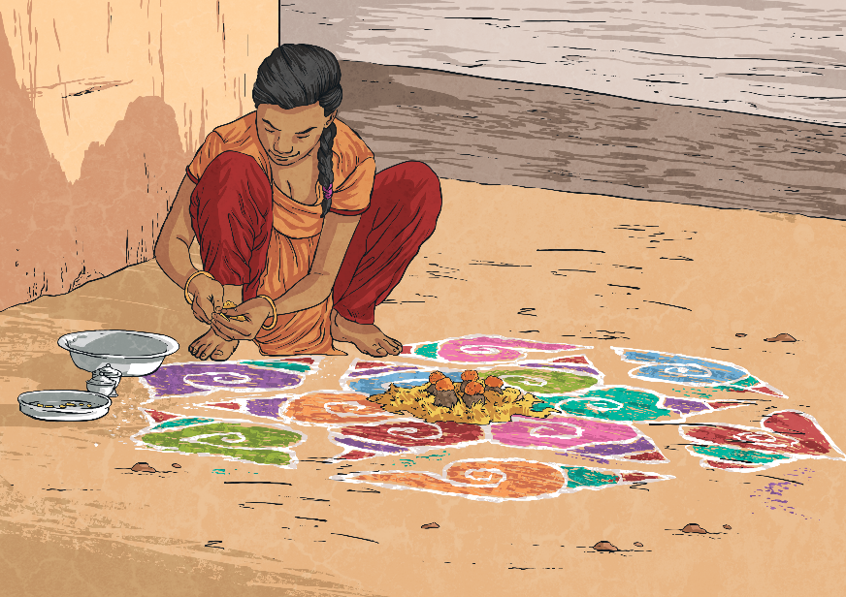
Diwali for Hindus
Rangoli patterns are drawn on the floor usually including a lotus flower as Lakshmi is associated with this flower.
People get together to eat in celebration and many Indians see Diwali as an occasion to gamble. This comes from a legend in which the goddess Parvati played dice with her husband and she said that anyone who gambled on Diwali night would be lucky.

Slide 6
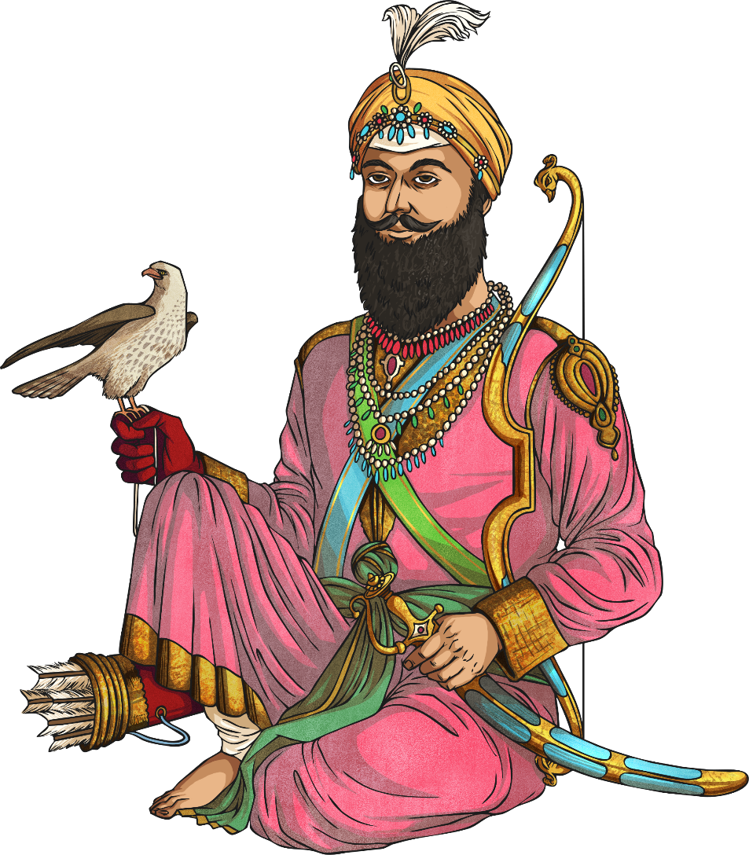
Diwali for Sikhs
For Sikhs, Diwali is really important as it celebrates the release from prison of the sixth guru, Guru Hargobind, and 52 other princes in 1619.
Sikhs celebrated the return of Guru Hargobind by lighting the Golden Temple and this tradition continues today.
Diwali is known as the 'festival of lights' because shops, public places and homes are decorated with small oil lamps called diyas.
Fireworks are also a huge part of the Diwali celebrations, although some Sikhs prefer not to use them because of the noise pollution and potential dangers.
People get together to exchange gifts and it is also an opportunity to celebrate a successful harvest.

Slide 7
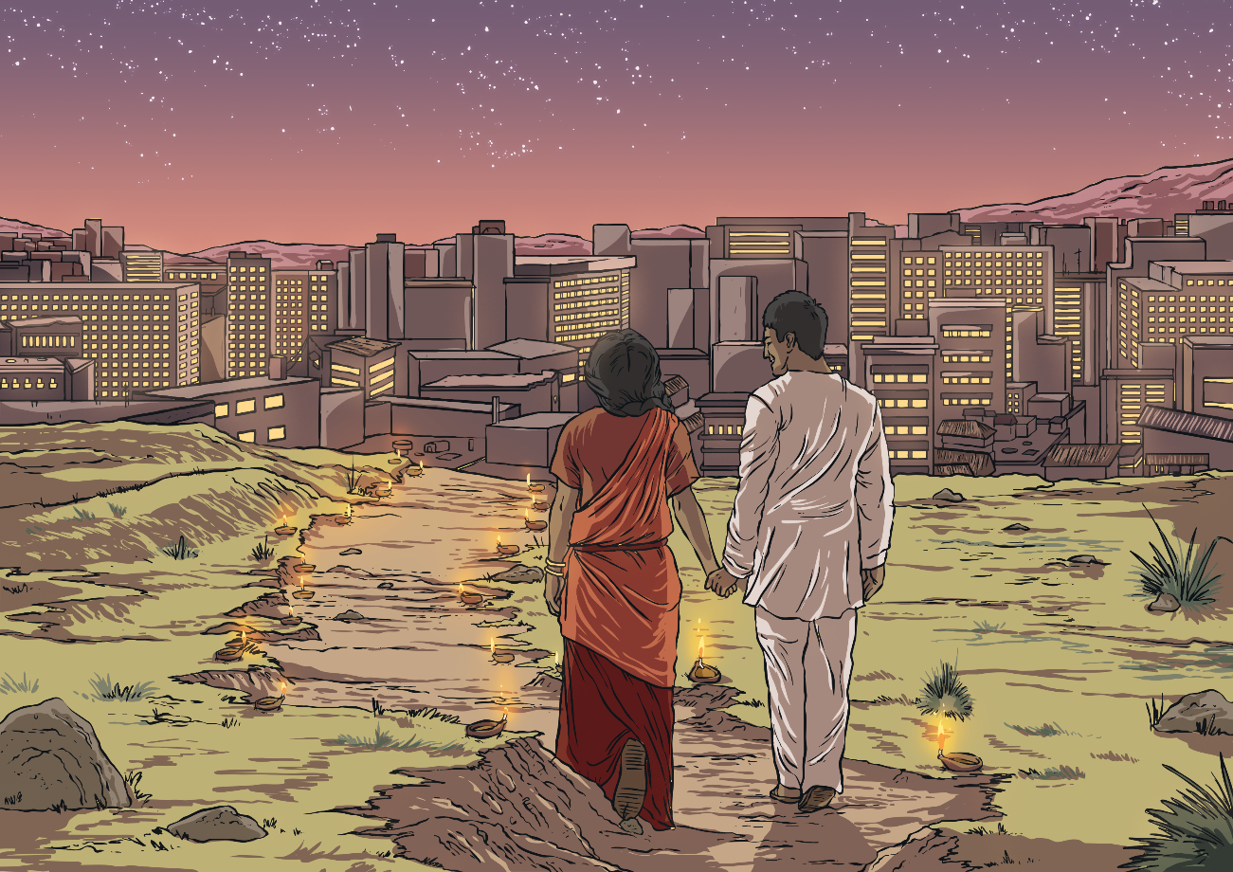
Activity
Compare the similarities and differences of Diwali for Hindus and Sikhs.

Slide 8
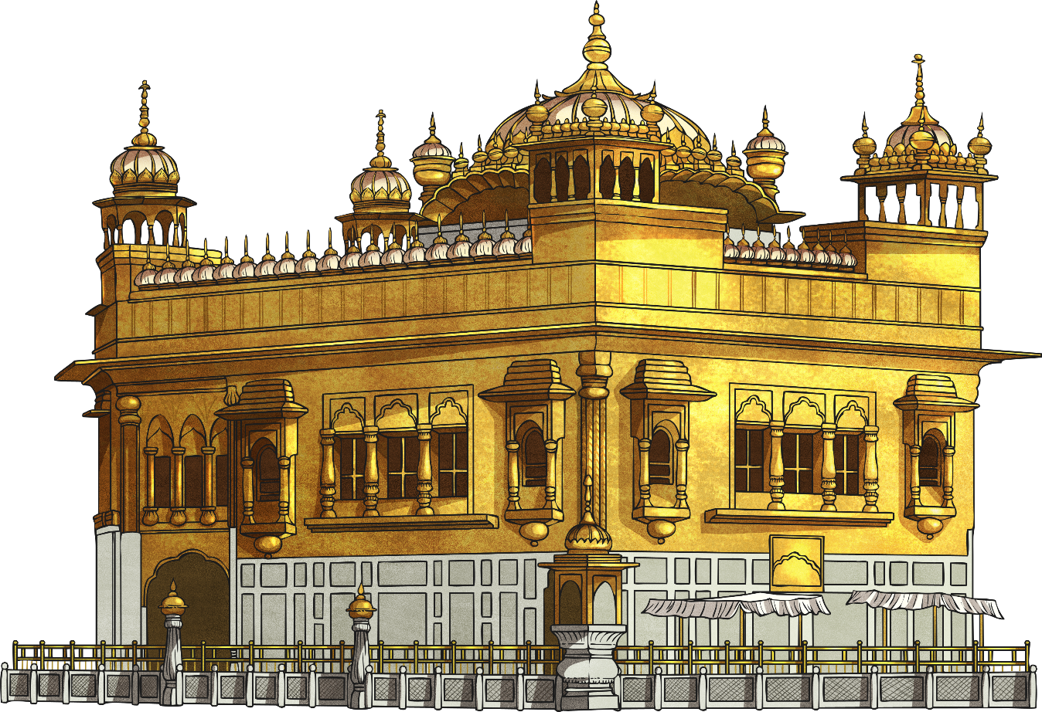
Plenary
Write down 3 new facts that you have learned about Diwali and then share these facts with a partner.
Add any new facts to your list.

Slide 9
Aim
To learn about how celebrating Diwali brings Sikhs and Hindus together.
Learning Outcomes
I know how Diwali is celebrated by both Sikhs and Hindus around the world.
I understand why Diwali is celebrated.

