Slide 2
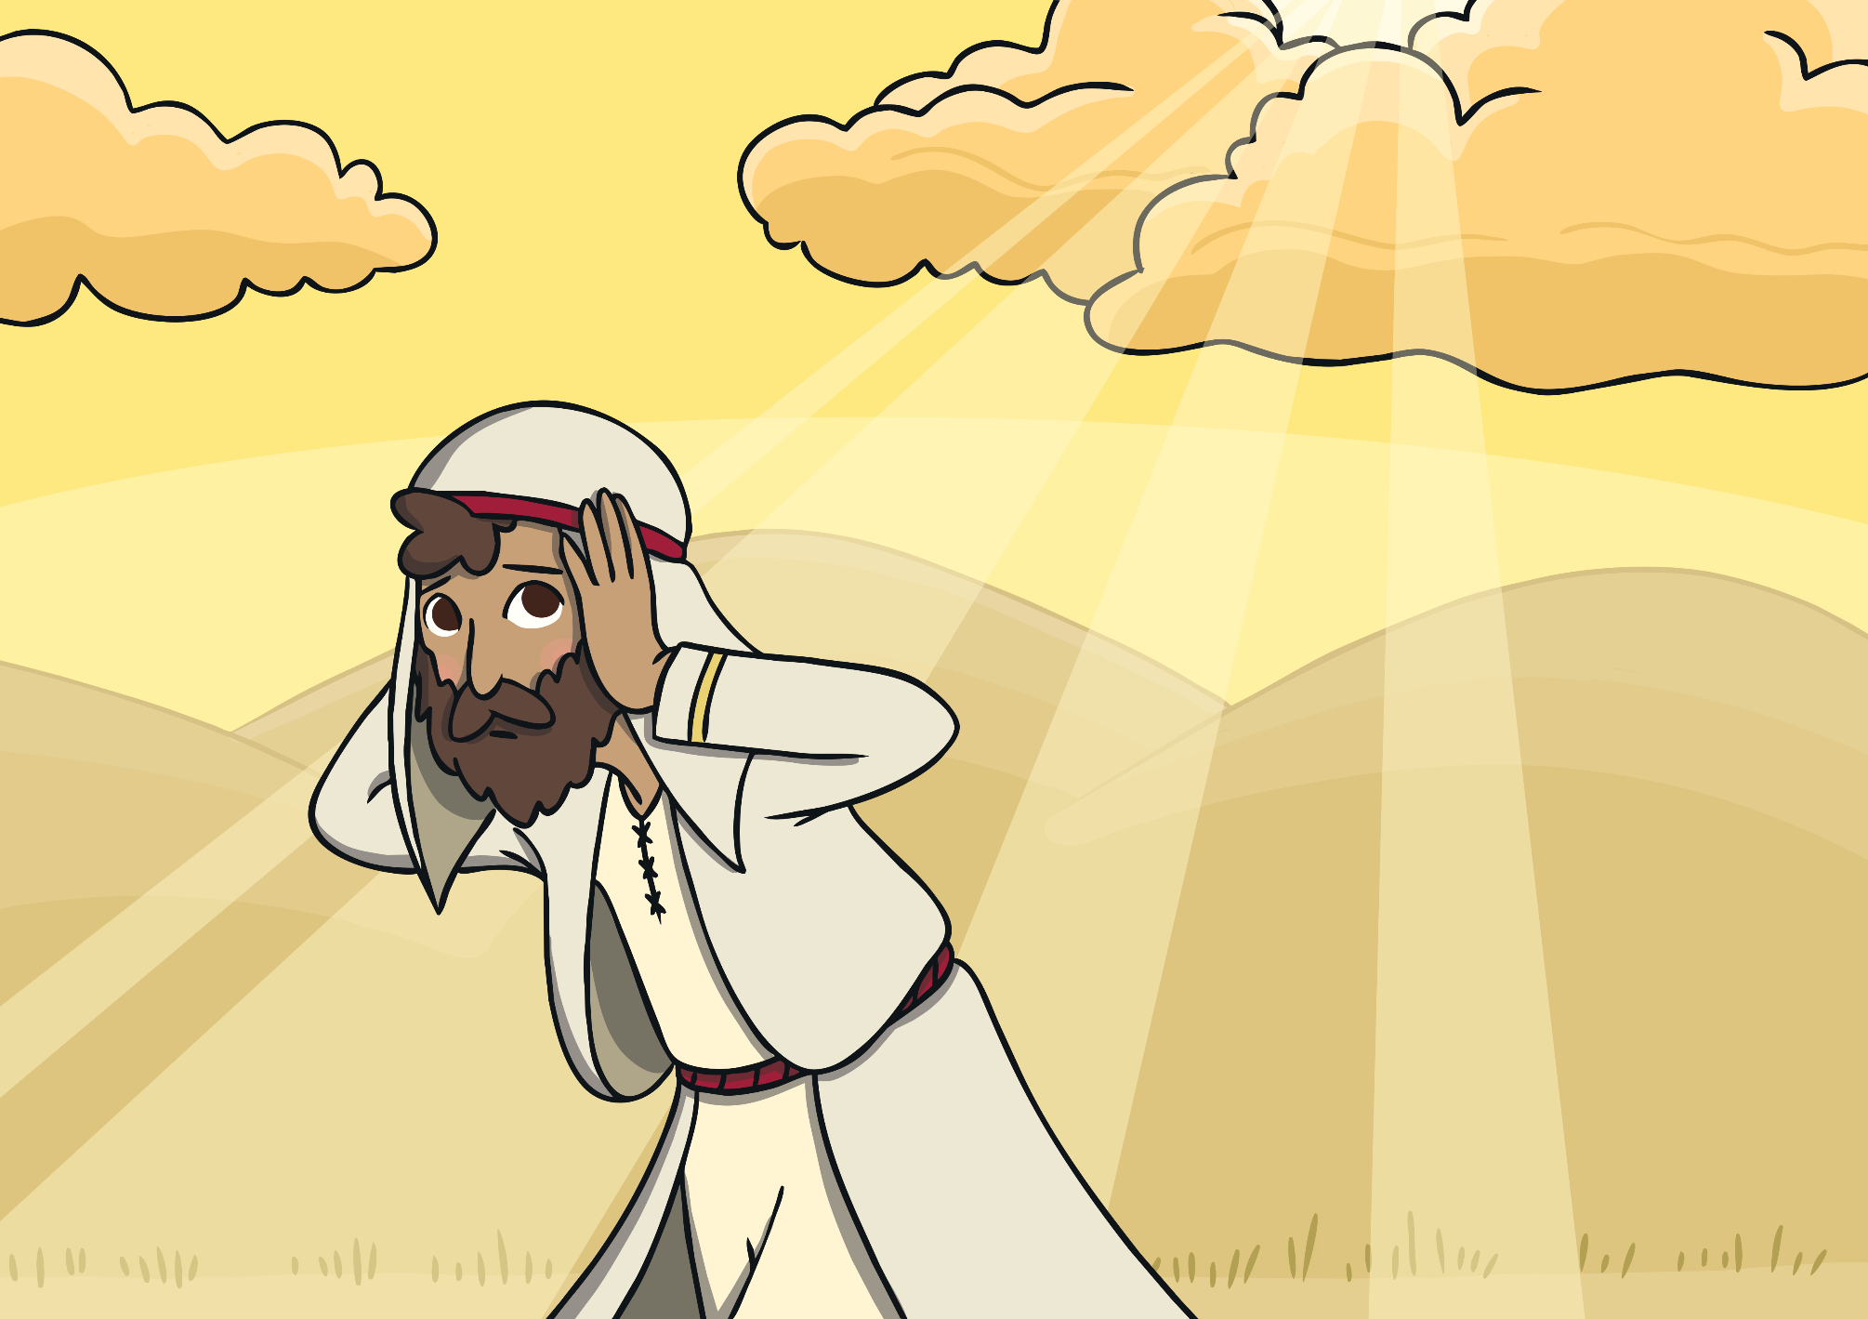
God said to Jonah, “Go to Ninevah.”
Jonah pretended not to hear God.

Slide 3
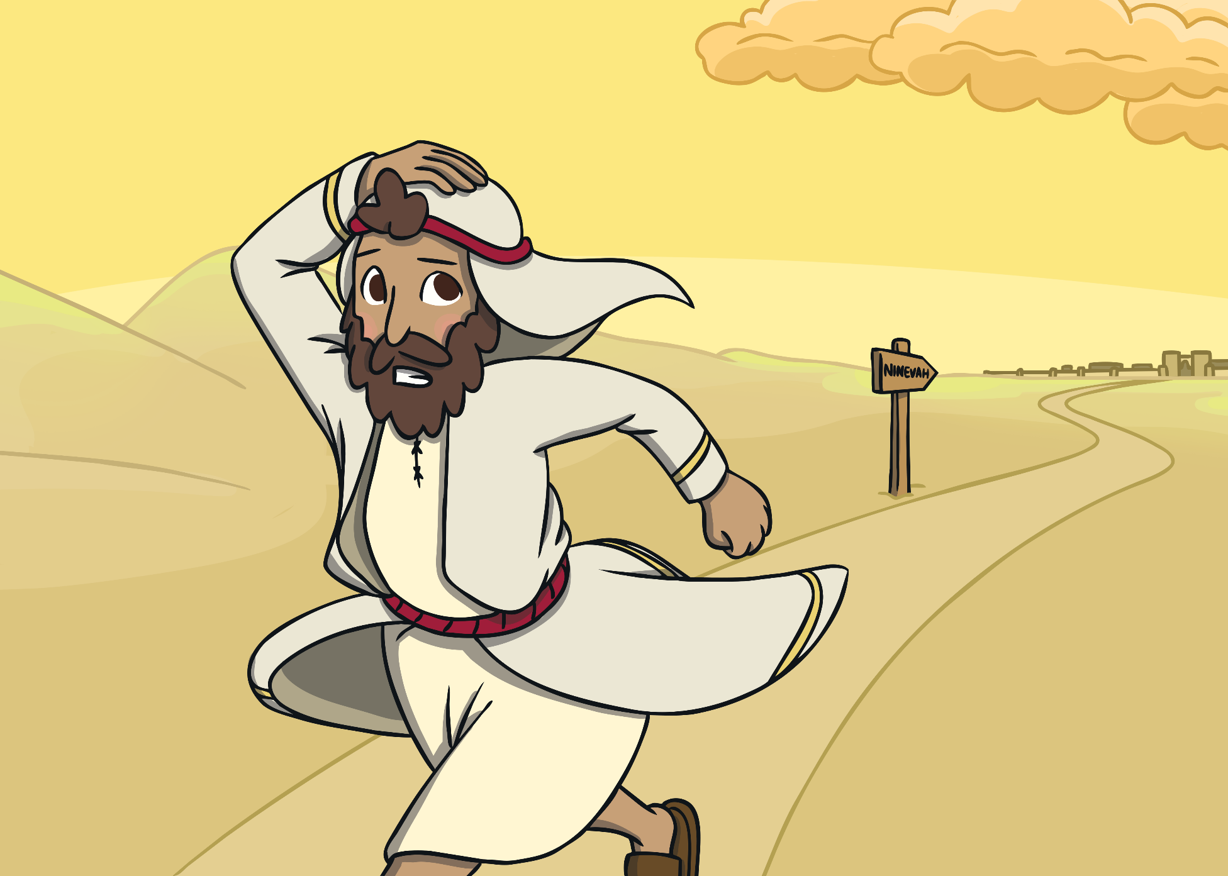
Jonah ran away from God because he didn’t want to do what God was asking. He knew the people of Ninevah were bad.

Slide 4
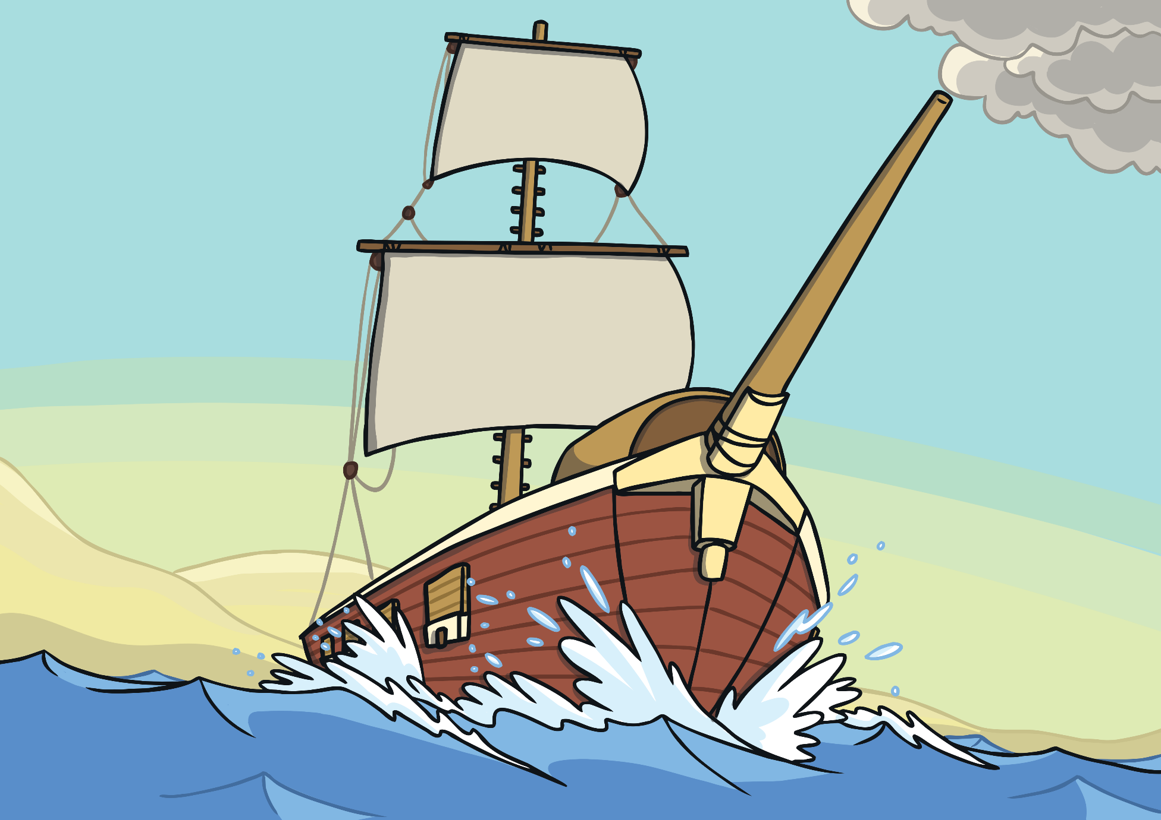
Jonah ran to the sea and got on a boat that was going away from Ninevah.

Slide 5
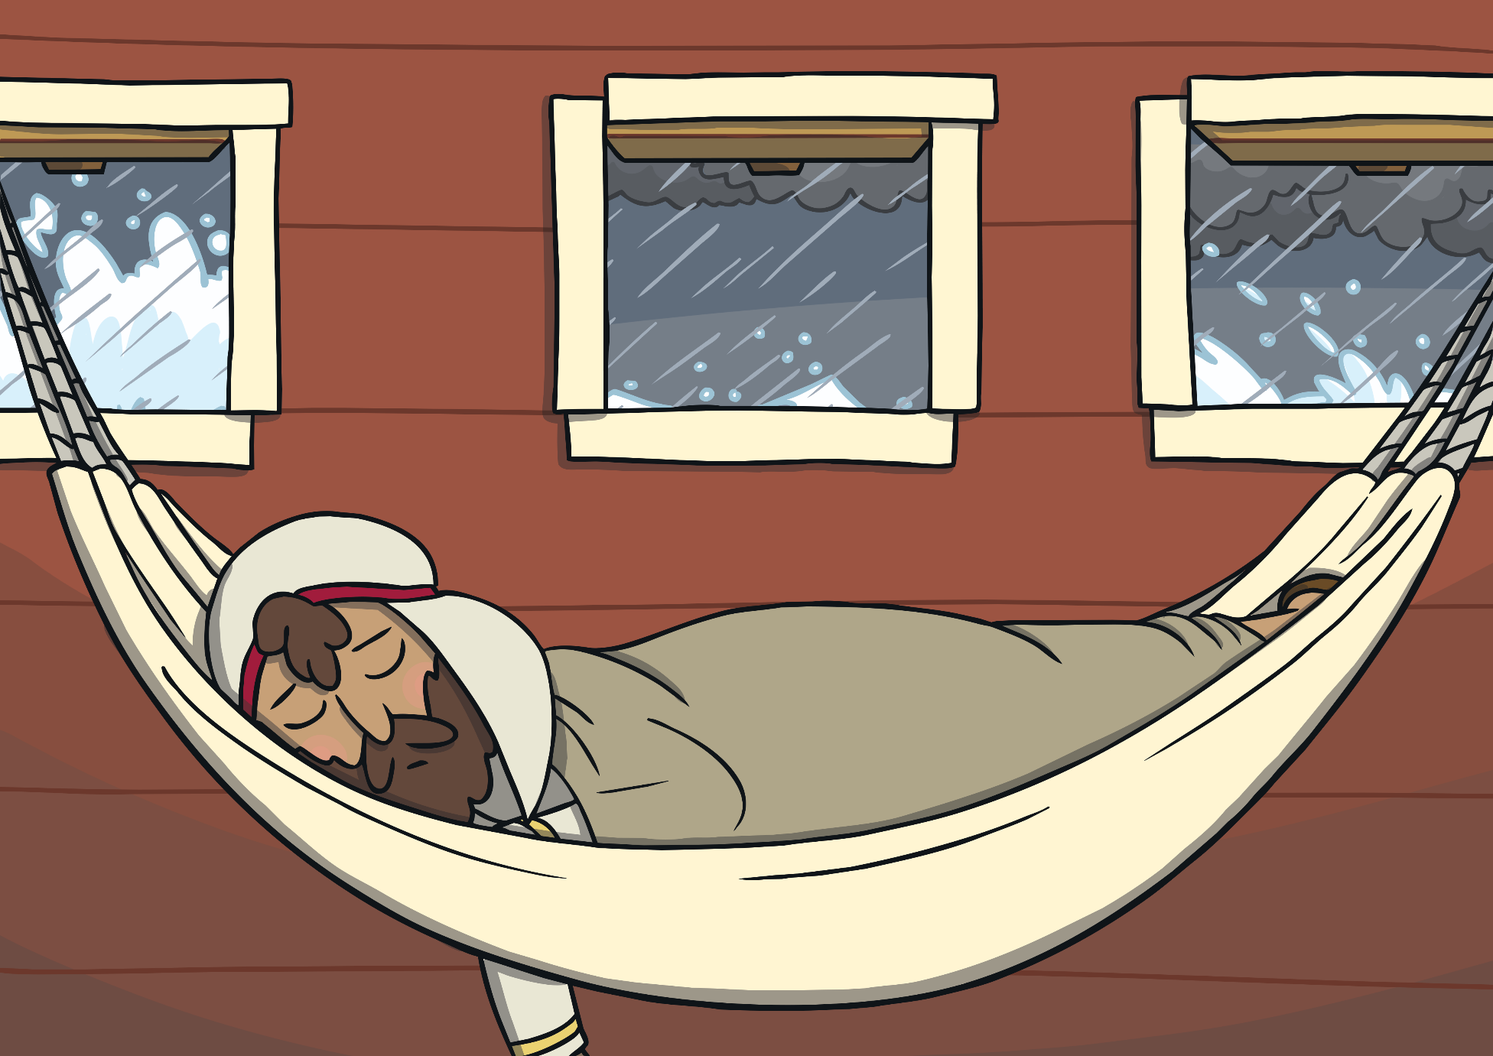
Jonah fell sound asleep on the boat and God sent a storm.

Slide 6
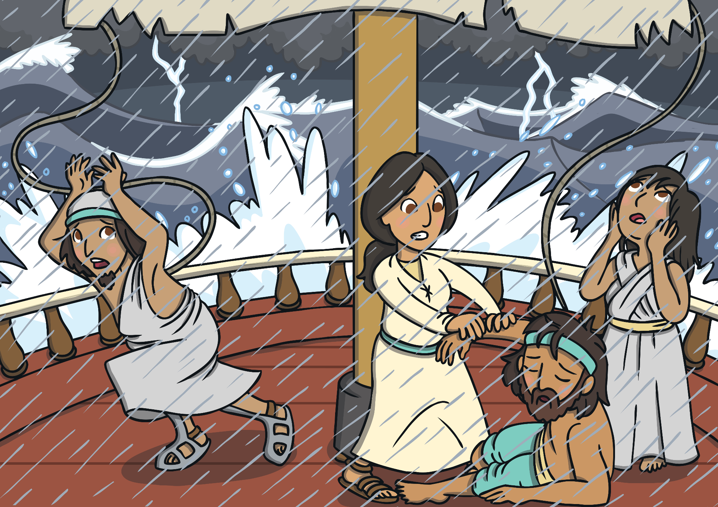
The other people on the boat were scared and worried, they knew that God was mad.

Slide 7
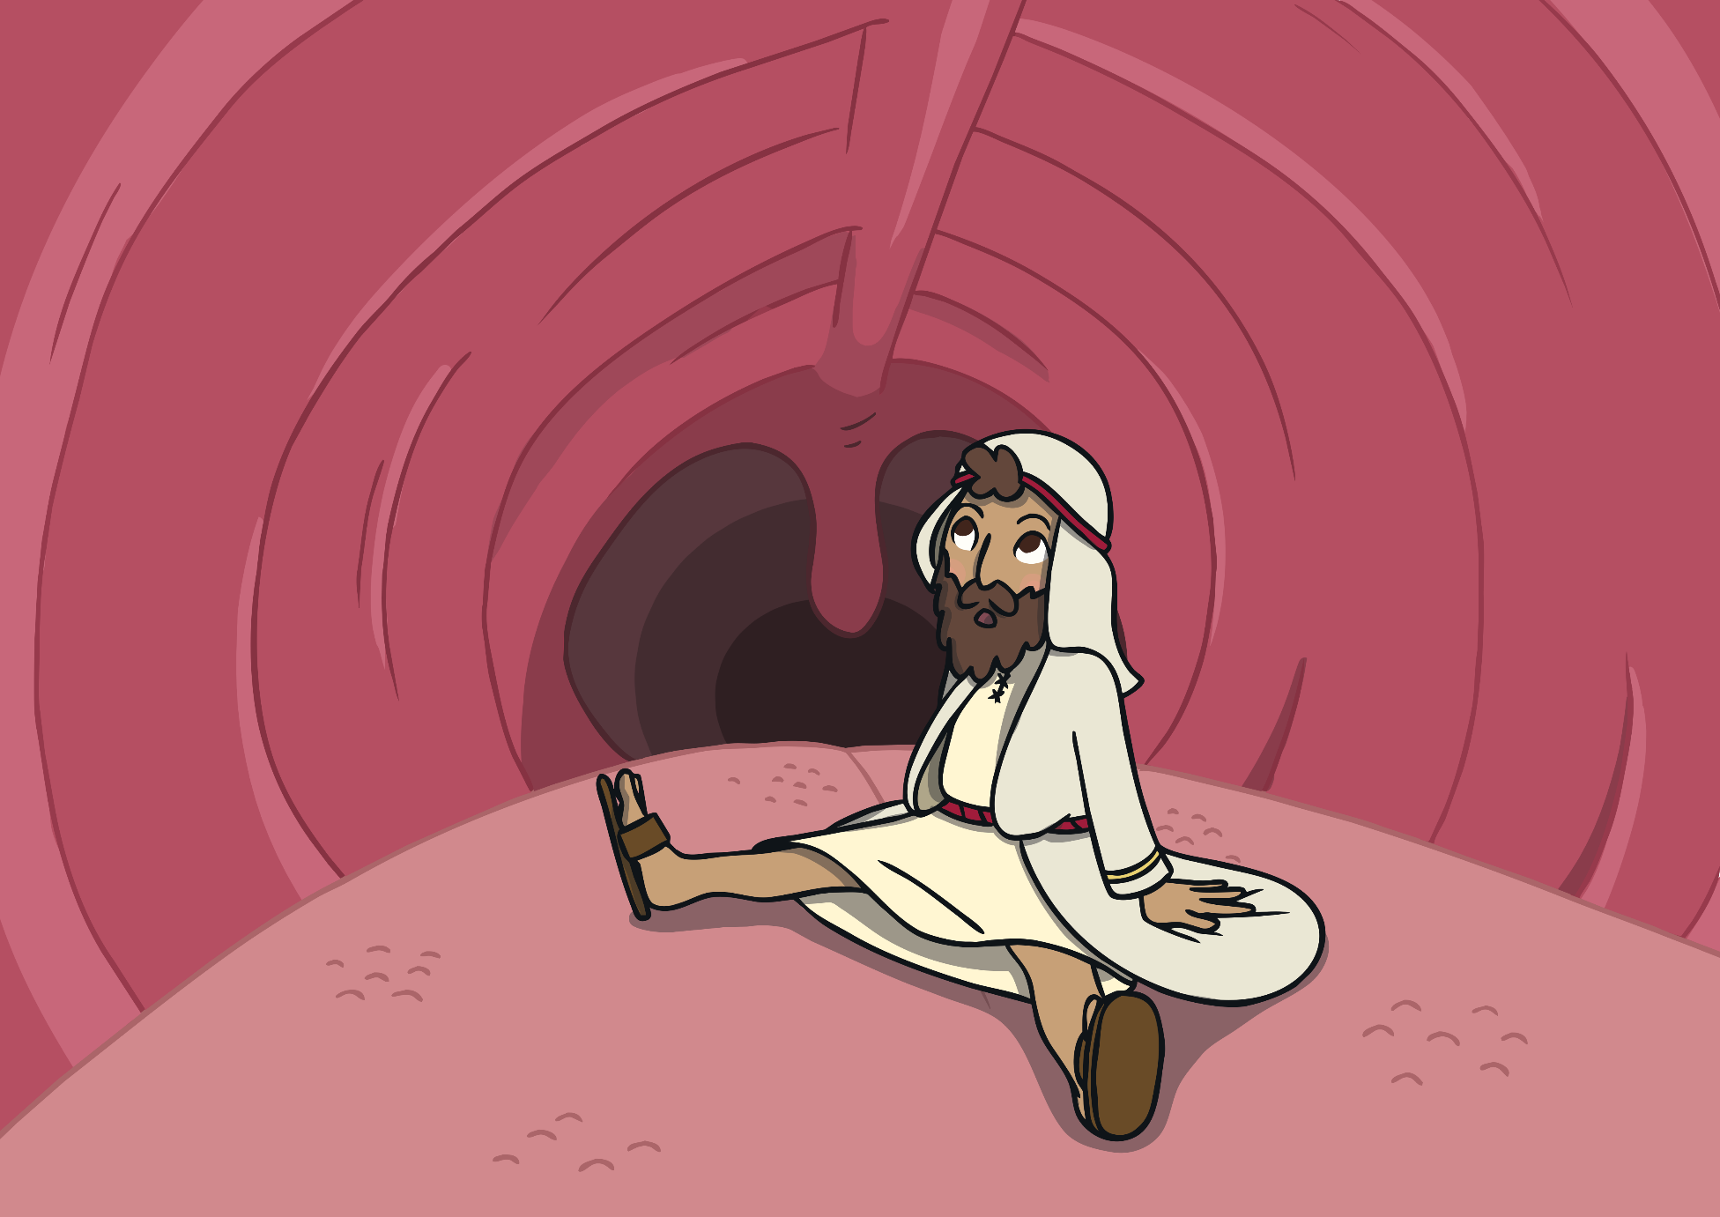
They woke Jonah up and threw him into the sea. Jonah was swallowed up by a huge fish.

Slide 8
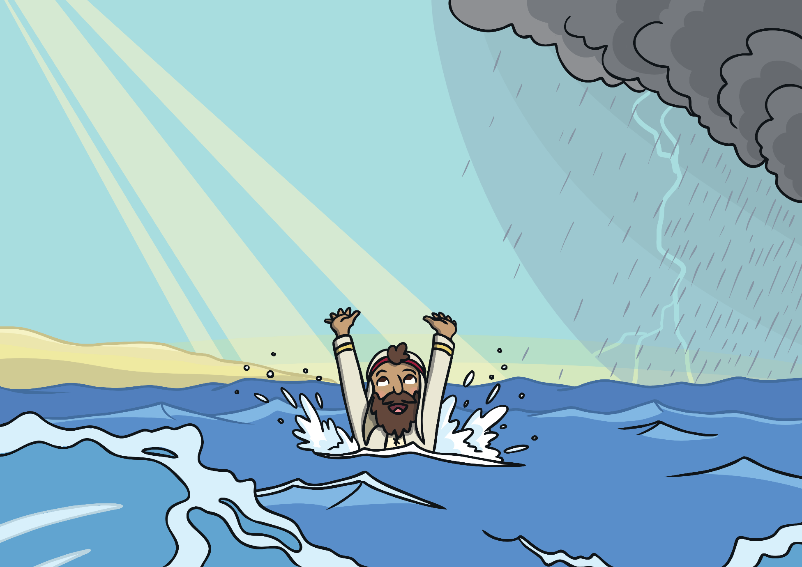
While Jonah was inside the fish, he said sorry to God and the fish spit Jonah out.

Slide 9
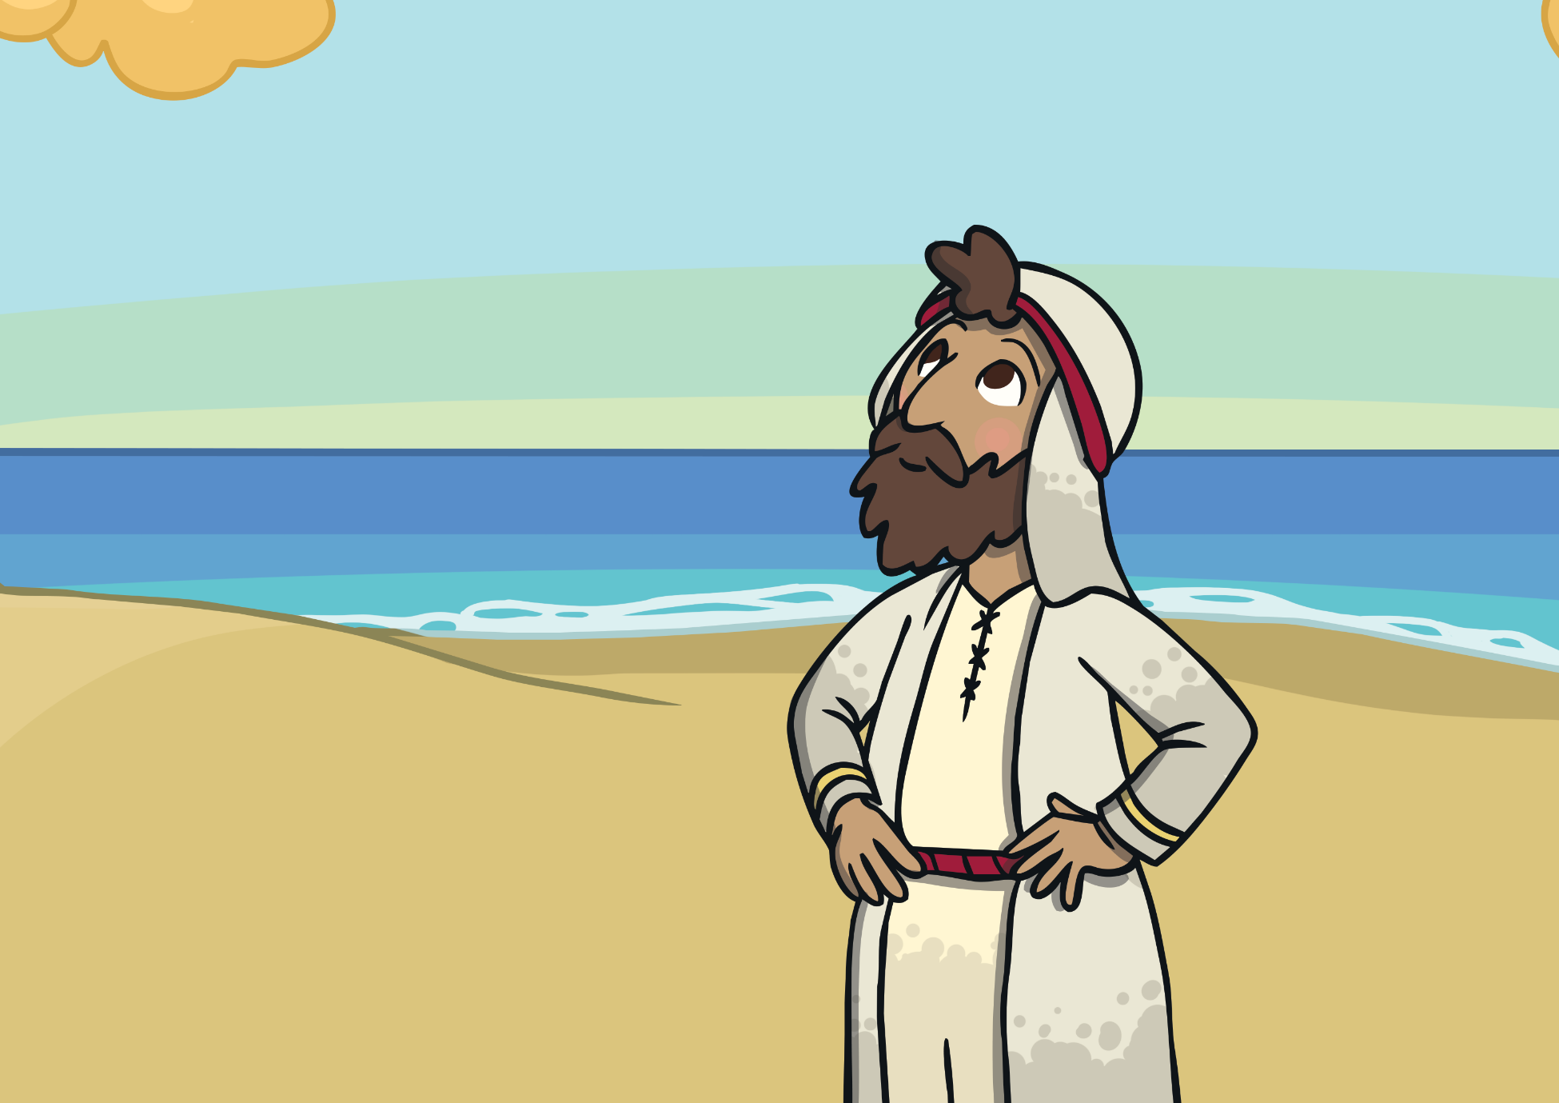
Jonah praised God and listened to him.

Slide 10

Once again God said to Jonah, “Go to Ninevah.”

Slide 11
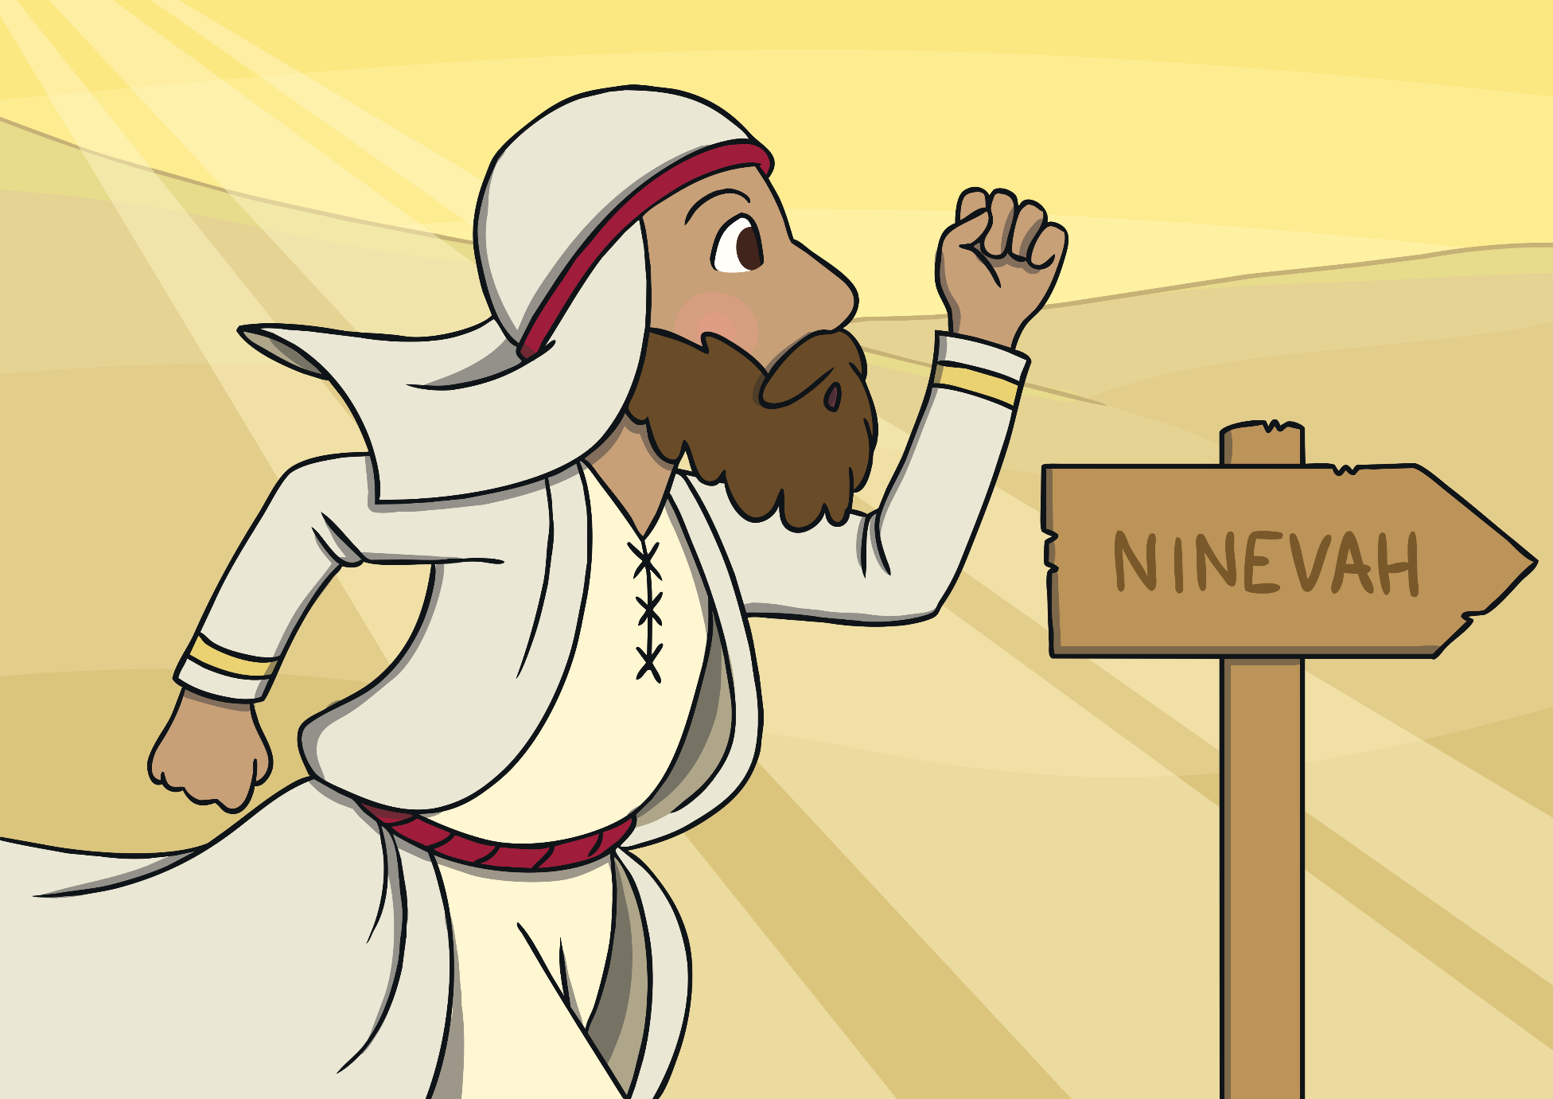
This time Jonah went and the people of Ninevah listened to him. They also said sorry to God.

