Slide 1



Buddhist Temples
All Buddhist temples contain an image or a statue of Buddha.
Buddhist temples are designed to symbolise the five elements.
Earth | Wisdom | Fire | Air | Water
The Earth is represented by the square base of the temple. | Wisdom is symbolised by the pinnacle at the very top. | The spire represents fire. | The crescent of a temple represents air. | The dome represents water.

Slide 2
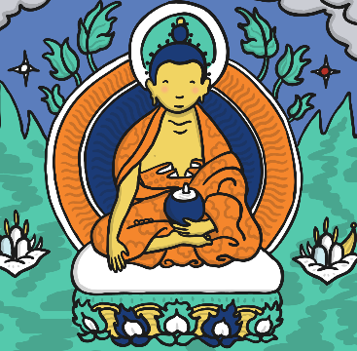
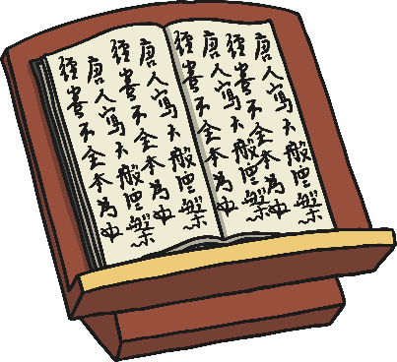
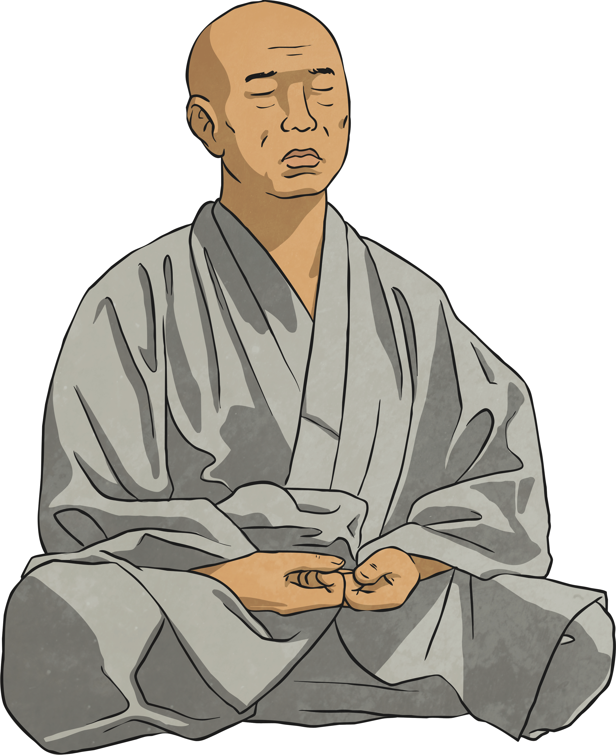

Important Features of a Buddhist Temple
Buddha
All Buddhist temples contain an image or statue of Buddha.
Lectern
From here, the head monk may give a talk to the worshippers.
Courtyard or Meditation Area
A temple may have a silent area for meditation.
Wheel of Life
This is the Buddhist symbol. You might see this if you are ever visiting a Buddhist temple.

Slide 3
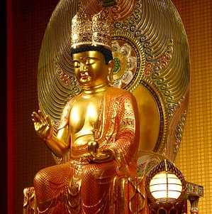
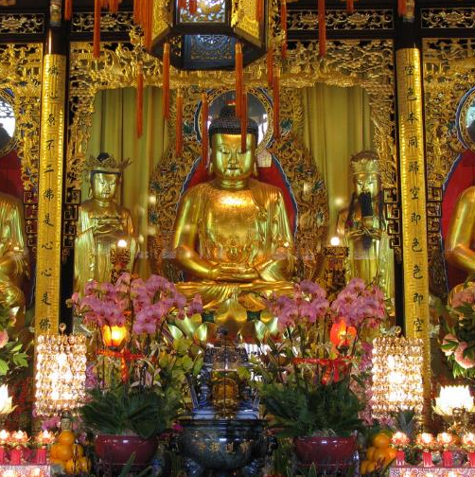
Why do People go to a Buddhist Temple?
People go to the temple to worship the image of Buddha.
Worshippers usually sit on the floor barefoot.
Worshippers give offerings to Buddha such as flowers or candles.
Worship is led by monks and is mostly meditation and chanting.
Photo courtesy of williamcho and oldandsolo (@flickr.com) - granted under creative commons licence - attribution

Slide 4
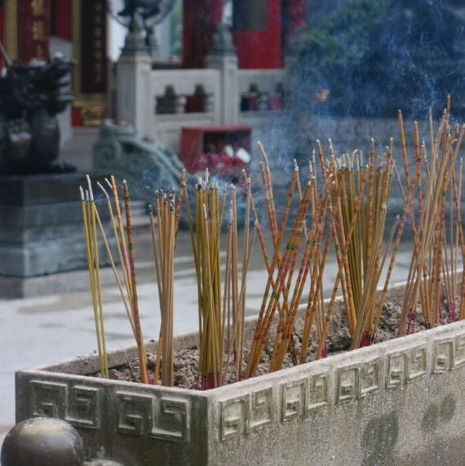
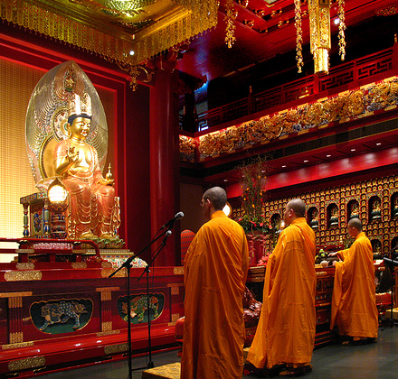
Why Do People Go to a Buddhist Temple?
Incense (a nice smelling fragrance) is used during worship to remind everyone that Buddha is all around them.
Many Buddhists believe that worshipping together with other Buddhists helps them to understand their religion better and to feel part of a faith family. Being in the temple also helps Buddhists to get better at meditation which is a way of being calm and still.
Photo courtesy of dungodung and williamcho (@flickr.com) - granted under creative commons licence - attribution

Slide 5
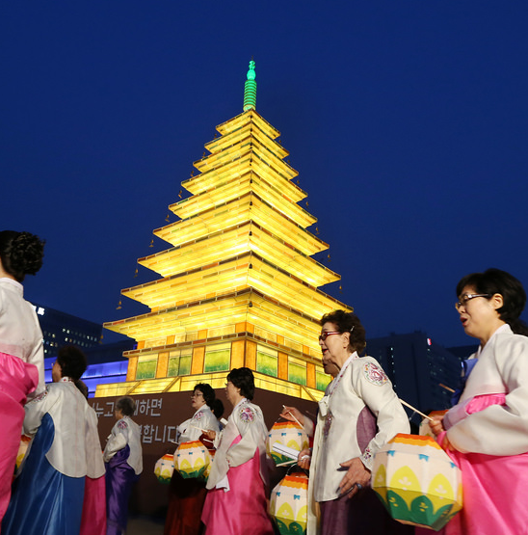
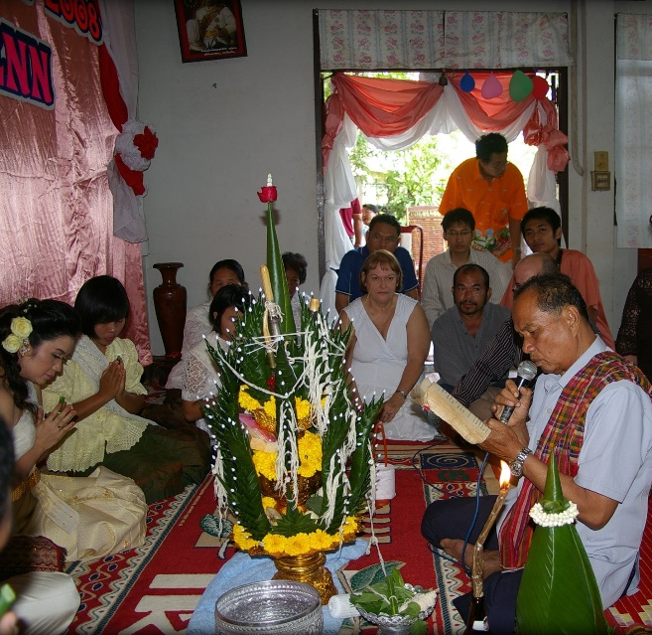
Why Do People Go to a Buddhist Temple?
Buddhists also attend temple for special occasions such as weddings and religious festival days.
Weddings
Buddhist weddings can take place in the temple or in the bride’s home. Prayers are recited then the bride says goodbye to her family and prays to her ancestors.
Photo courtesy of williamcho and oldandsolo (@flickr.com) - granted under creative commons licence - attribution

Slide 6
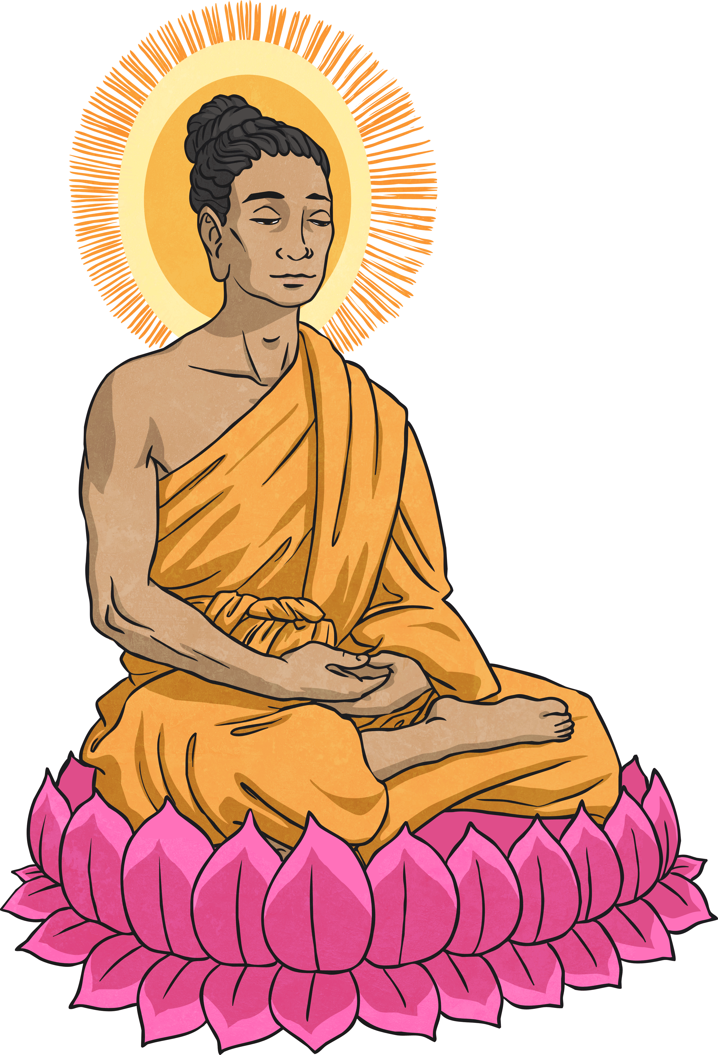
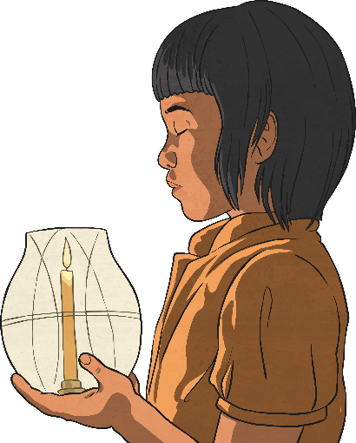
Why Do People Go to a Buddhist Temple?
Buddhists believe their lives are a cycle of death and re-birth until they reach Nirvana. Nirvana is thought to be the end of the cycle and is achieved only when all want is gone and true happiness is found.
Nirvana Day
This is a special annual festival which remembers the death of the Buddha, when he reached Nirvana. Buddhists spend Nirvana Day meditating and visiting their temple.
Wesak
This is the most important day in the Buddhist calendar as it celebrates Buddha’s birthday. Buddhists visit their local temple for services and teaching, taking offerings of flowers, candles and food.

Slide 7
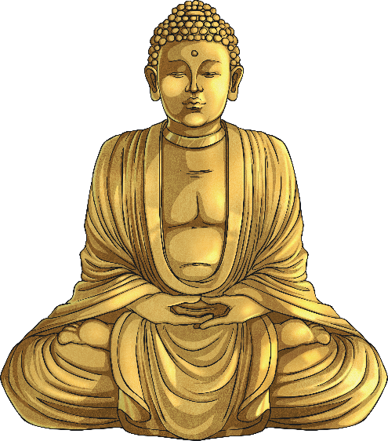
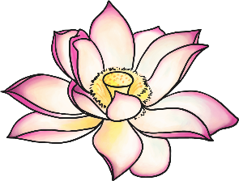
Buddhist Worship at Home
Buddhists can worship both at the temple and at home.
In a Buddhist home, there will be one room or area used as a shrine with a statue of Buddha, incense and candles.
Having a shrine in the home is an opportunity for a Buddhist to worship daily.

Slide 8
Showing Respect
No talking in the shrine room.
Wear appropriate clothing and no shoes to be worn inside.
Special books should be kept off the floor.
Sit with your legs crossed on the floor, do not straighten out your legs (this is a sign of disrespect, so is lying down).
Bow to the statue of Buddha.
Make offerings.

Slide 9

Plenary
?
?
?
Why do you think visiting the temple is important to many Buddhists?
Do you have any further questions about Buddhist temples?

