Slide 2
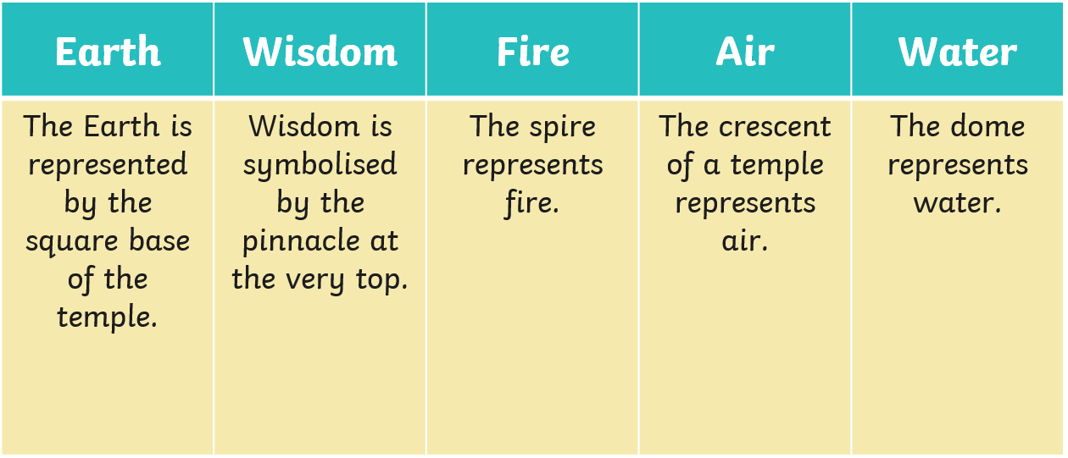

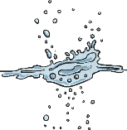


Buddhist Worship
Buddhist worship is called ‘Puja’.
A Wat is a Buddhist temple that most Buddhists visit on special religious days (often when it is a full moon).
Try It Activities:
Use the information about the features of a Buddhist temple and design your own.
Buddhists often have a shrine in their home where they thank Buddha for his teachings. Buddhists chant to show their love for the Buddha and make offerings of flowers, incense, candles and pure water.

Slide 3
Meditation
Meditation is of great importance for Buddhists. In fact, Buddha became enlightened after a long period of time spent meditating. Buddhists believe it is important to clear the mind of worries and to resist distractions. This helps to open one’s mind to wisdom and understanding.
Try It Activities:
Focus on this picture or close your eyes.
Concentrate on your breathing. Try to empty your mind of all cares, worries and thoughts.
As you breathe in, think about all the blessings you have.
As you breathe out, breathe away all your concerns.
Meditation Music
Notes:
Teacher Note - Please check the content in this link, including any comments, is suitable for your educational environment before showing. Please do not let the next video automatically play at the end of the clip. Twinkl accepts no responsibility for the content of third party websites.

Slide 4


Slide 5


Asala-Dharma Day
Asala-Dharma Day is when Buddhists celebrate the beginning of Buddhism and Buddha’s teachings on the first full moon of the eighth lunar month.
Dharma means truth - doing the right thing in speech, thoughts, action and right mindfulness.
Buddhists might give thanks at the temple, light candles, burn incense and reflect on the Four Noble Truths.
Try It Activity:
Share it - Are there any other religions where people light candles?

Slide 6
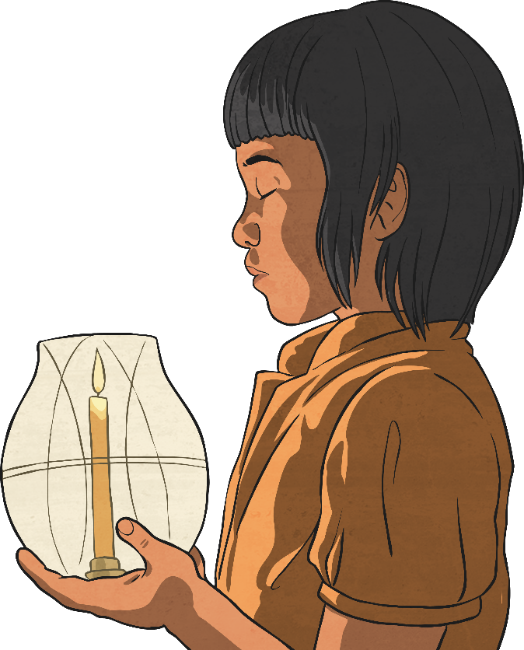
Wesak Celebrations
Wesak is the most important Buddhist festival. It is celebrated on the full moon in May. This is a celebration of the Buddha’s birthday.
To celebrate, Buddhists might clean and decorate their homes, chant, pray and go to listen to teachings at their local temple or give gifts to the Buddha statues. Different countries celebrate Wesak in different ways.
Try It Activity:
Make your own lotus origami flower decoration by following the simple step-by-step instructions here.

Slide 7
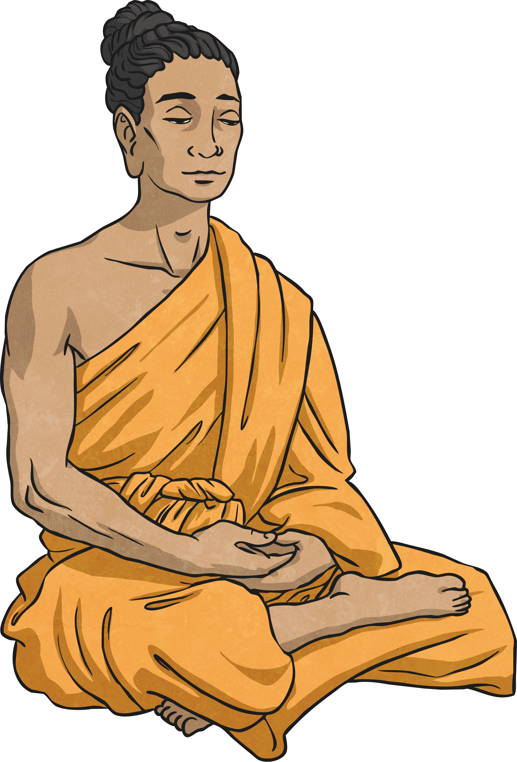


Buddha
Who was Buddha?
A man
A god
A priest

Slide 8
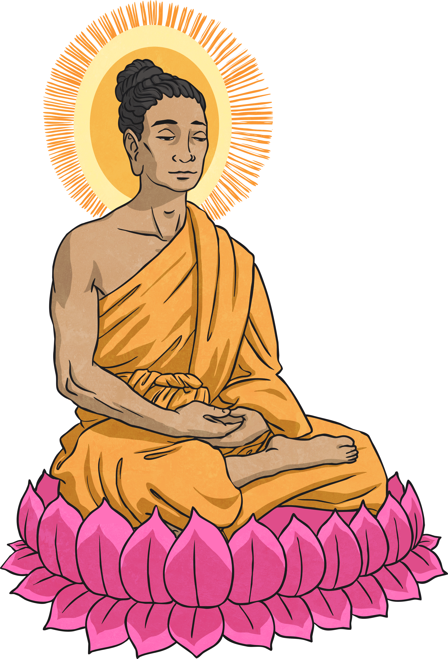
Buddha
What did Siddhartha Gautama learn when he left his palace?
That there would always be suffering in the world.
That meditation was the only way to happiness.
That no one else could reach enlightenment.

Slide 9
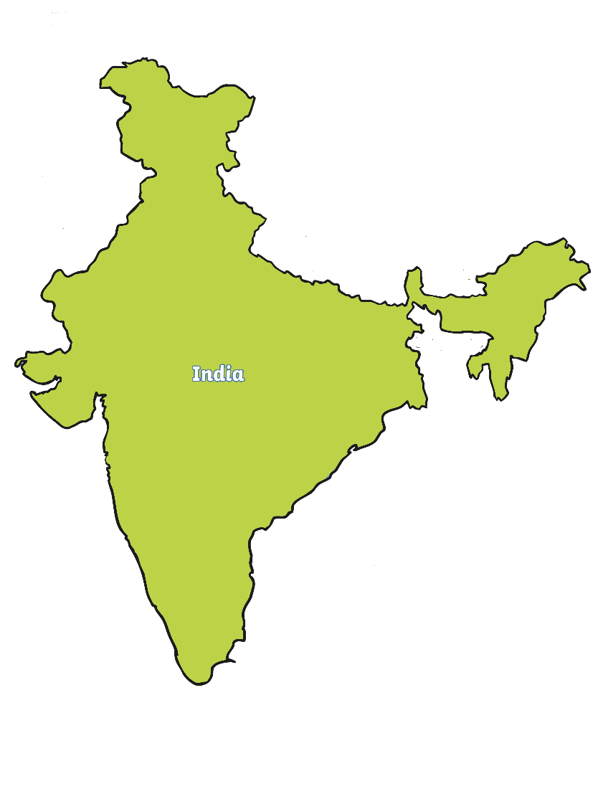
India
Which continent is India in?
Europe
South America
Asia

Slide 10
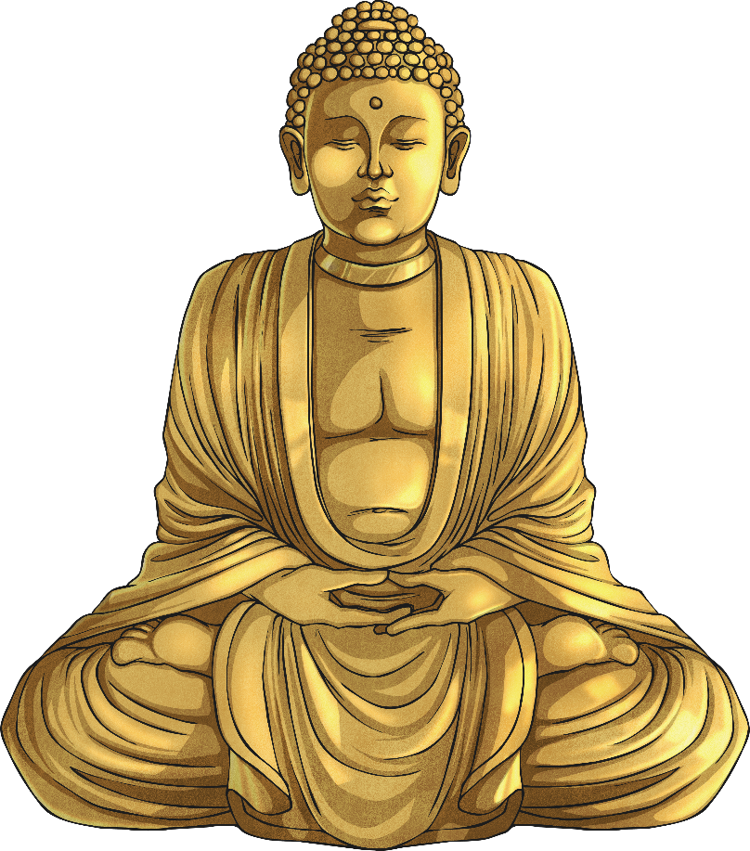
Reincarnation
Buddhists believe in reincarnation. What does that mean?
That everyone should do what they want.
That actions have consequences for the future.
That living beings will die and come back as other living beings.

