Slide 2

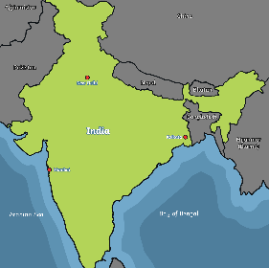
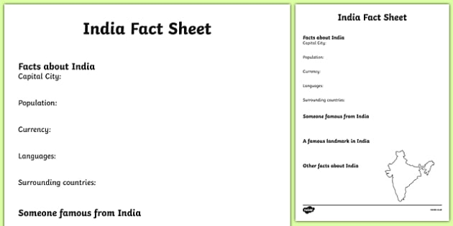
India
The Buddha was born in Lumbini, which was part of northern India, but is now part of Nepal.
Buddhism originated in India.
India is in the largest continent of the world: Asia.
Click to see a bigger map
Try It Activities:
Find out some facts about India and record them in this fact file template.

Slide 3
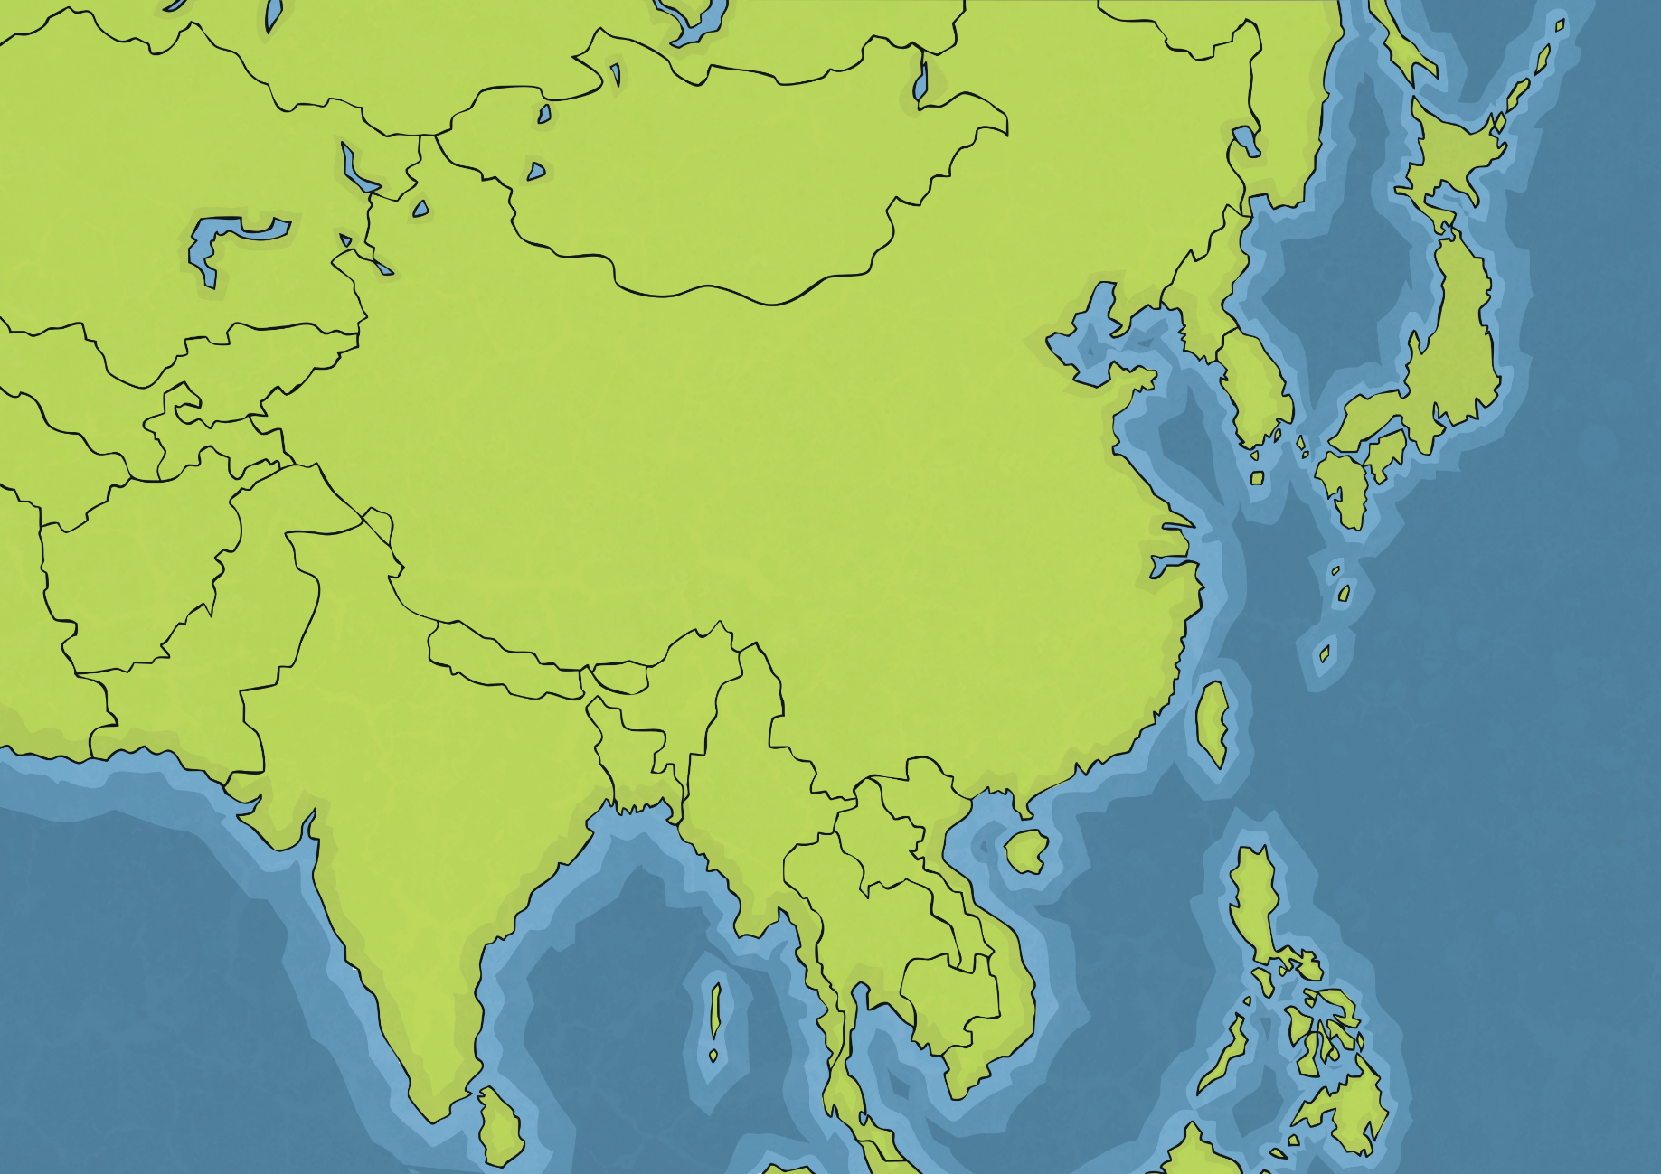
Kazakhstan
Mongolia
Afganistan
China
Pakistan
Nepal
India
Burma
Thailand

Slide 4

The Five Buddhist Morals
Many believe that Buddhism is more of a ‘philosophy of life’ rather than a religion. They believe that Buddhism teaches people:
to lead a moral life;
to be mindful and aware of thoughts and actions;
to develop wisdom and understanding.
Try It:
Get into small groups to discuss and create a short play demonstrating an example of one of these philosophies of life.

Slide 5






The Five Buddhist Morals
Click on the numbers to find out about the morals of Buddhism.
1
Do not take the life of any living thing.
2
Do not steal.
3
Be faithful to your partner.
4
Do not lie.
5
Do not drink alcohol.

Slide 6
The Four Noble Truths
Click on the truths to find out about more about them.
Dukkha
Suffering exists: people feel lonely, angry or frightened.
Samudaya
There is a cause for suffering: a need to control something, or a craving. For example, a desire for fame, money, or to avoid unpleasant feelings.
Nirodha
There is an end to suffering: suffering can be overcome if we let go of our desires and learn to live each day at a time without going over the past or imagining a perfect future.
Magga
In order to end suffering, follow the Eightfold Path: the set of eight rights, or instructions, concerned with wisdom, morality and meditation.

Slide 7

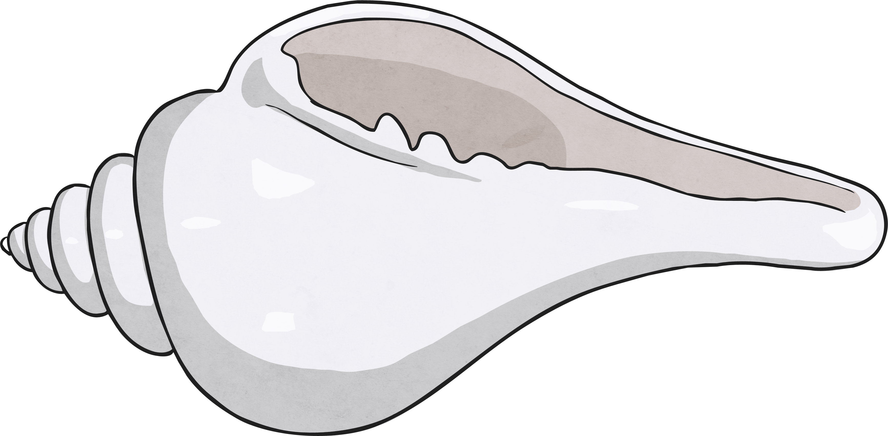


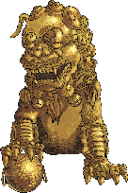


Buddhist Symbols
Click on the symbols to find out about more about them.
Lotus Flower: This represents the rise up from suffering to reach enlightenment, beauty and understanding.
Parasol: This represents protection from suffering and harmful forces.
The Dharma Wheel: The eight spokes represent the Eightfold Path.
The Eternal Knot: This represents how everything is linked, especially compassion and wisdom.
More symbols

Slide 8
Buddhist Symbols
Click on the symbols to find out about more about them.
The Lion: This represents the power of Buddha’s teachings.
The Golden Fish: This represents luck, fortune and having courage to face the ocean of suffering.
The Conch Shell: This represents the sudden understanding
of people who hear the Buddhist teachings.

Slide 9

The Eightfold Path
The Eightfold Path is a set of rules or instructions for people to follow to reach enlightenment.
Wisdom
Right Understanding
Right Aspiration
Morality
Right Speech
Right Action
Use these drama cards to explore the Eightfold Path in more depth.
Right Livelihood
Concentration
Right Effort
Right Mindfulness
Right Concentration

Slide 10


Karma
Buddhists believe in karma. This means that our past actions affect us, either positively or negatively, and that what we do in the present time will affect us in the future.
Buddhists believe in the cycle of reincarnation, which means a living being is ‘reborn’ as another living being after their death. Their soul is eternal and enters a new body. The cycle of death and reincarnation continues until they reach enlightenment. This endless cycle is called Saṃsāra.
How do you think a person’s behaviour might change if they believed in reincarnation and karma?
People who have lived good lives are reincarnated as ‘higher order’ animals than people who have lived bad lives.
If a person has lived an exceptionally good life, it is believed that they escape the cycle and spend eternity in the heavenly realms. This is called nirvana.
Think About It Activity:

