Slide 1
The Images of Buddha

Slide 2
The Images of Buddha
There are a great many statues and images of Buddha and he can often look very different in each one.
Buddha lived almost 2500 years ago so there is little way of knowing what he actually looked like.
Buddhist statues use symbolism to portray meaning and help us to understand the sort of character Buddha was.

Slide 3
The Hands of the Buddha
Buddha is represented in many different ways but they all use the same five hand positions, known as ‘mudras’.
Mudras are seen to represent the five different qualities of an enlightened mind.

Slide 4
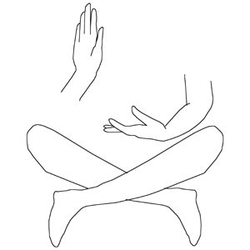
Varada Mudra - Compassion
The left hand is open, resting on the left knee, with the palm facing forwards and the thumb meeting the forefinger; the right hand raised with the palm facing forwards.

Slide 5
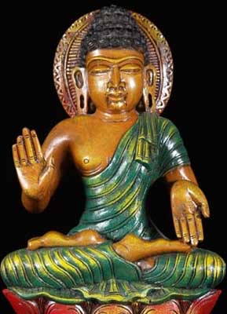
Abhaya Mudra – Reassurance and Protection.
The left hand is open, resting on the left knee, with the palm facing outwards; the right hand raised with the palm facing outwards.

Slide 6
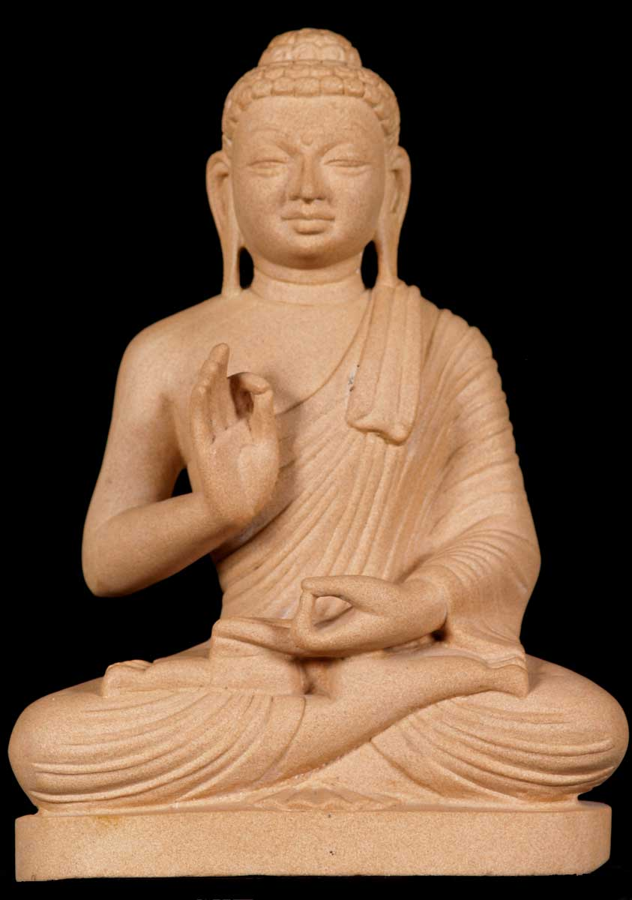
Vitarka Mudra – Teaching
The Buddha teaching his followers the middle way.
Right hand facing outwards with the forefinger and thumb touching; left hand resting on the left knee with the thumb and forefinger touching.

Slide 7
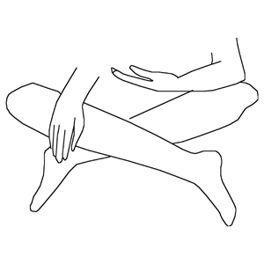
Bhumisparsa Mudra – Earth Touching
The Buddha is said to have called upon the Earth to witness his enlightenment.
Right hand reaching down with fingers touching the ground. Left hand facing upwards.

Slide 8
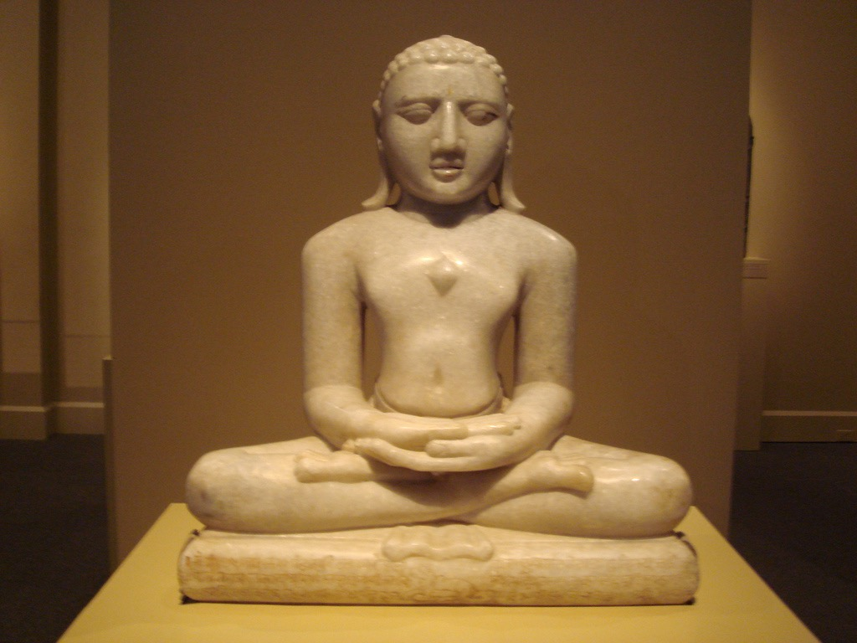
Dhyana Mudra – Concentration and Meditation
Hands on the lap, one on top of the other, with the palms facing upwards.
This represents Buddha sitting on the lotus throne.

Slide 9
Images of Buddha
Buddha’s hands aren’t the only symbol used in images of Buddha.
Here are some other ways in which the image of Buddha is traditionally used to give meaning.

Slide 10
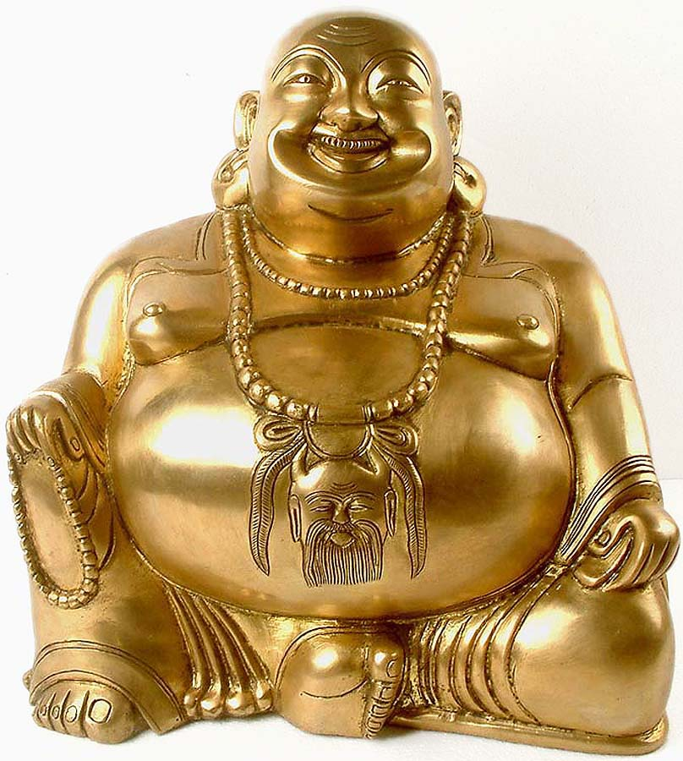
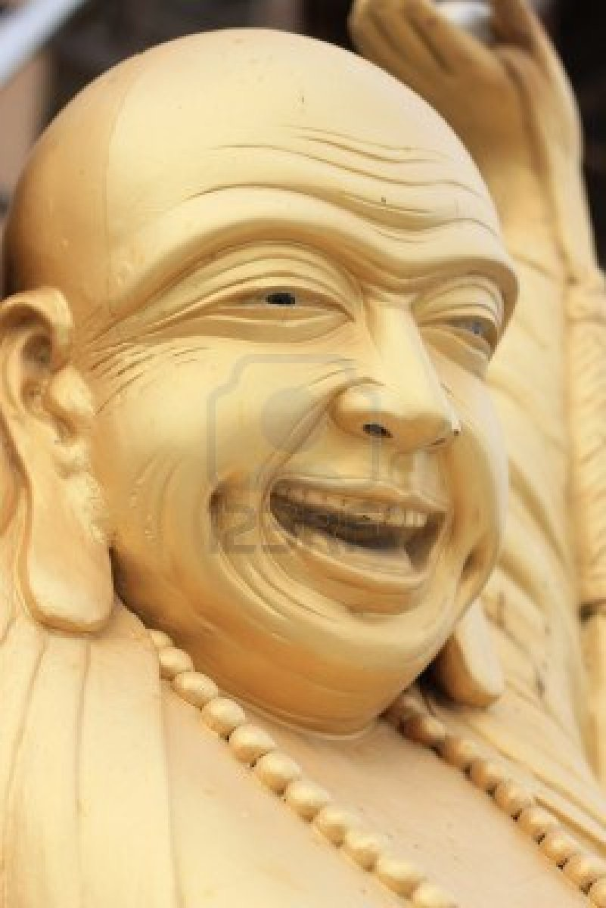
The Laughing Buddha
The laughing Buddha reminds us that to be happy we have to have a loving heart.
A big happy smile reaches your eyes and your heart and helps you tolerate many things.

Slide 11
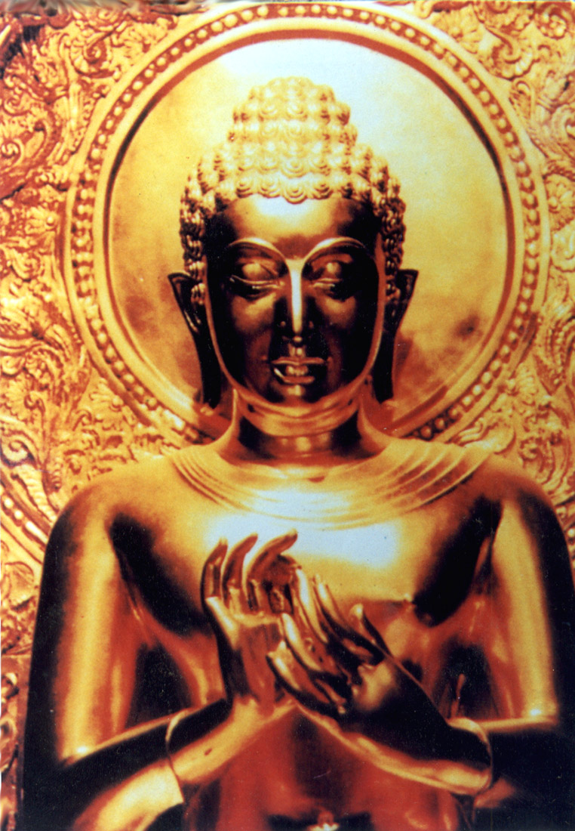
Bump on Buddha’s Head
A bump on Buddha’s head was a symbol that he had many talents.

Slide 12
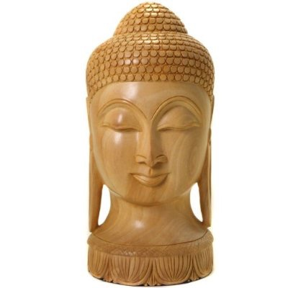
Long Ears
Buddha is often shown with long ears because of the heavy earrings he wore when he was a wealthy prince that have now been removed because he renounced his worldly life.

Slide 13
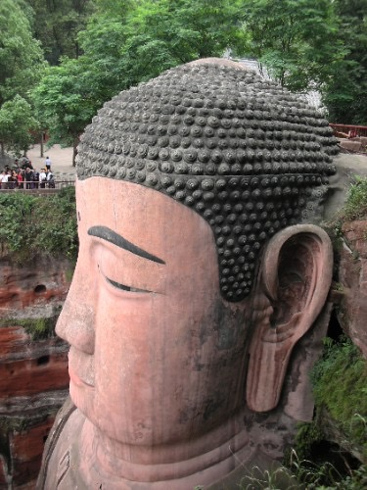
Curly Hair
Buddha is often shown with what looks like curly hair on his head. Actually his head was shaven and the curls are snails that kindly covered his head to protect him from the sun as he sat meditating.

Slide 14
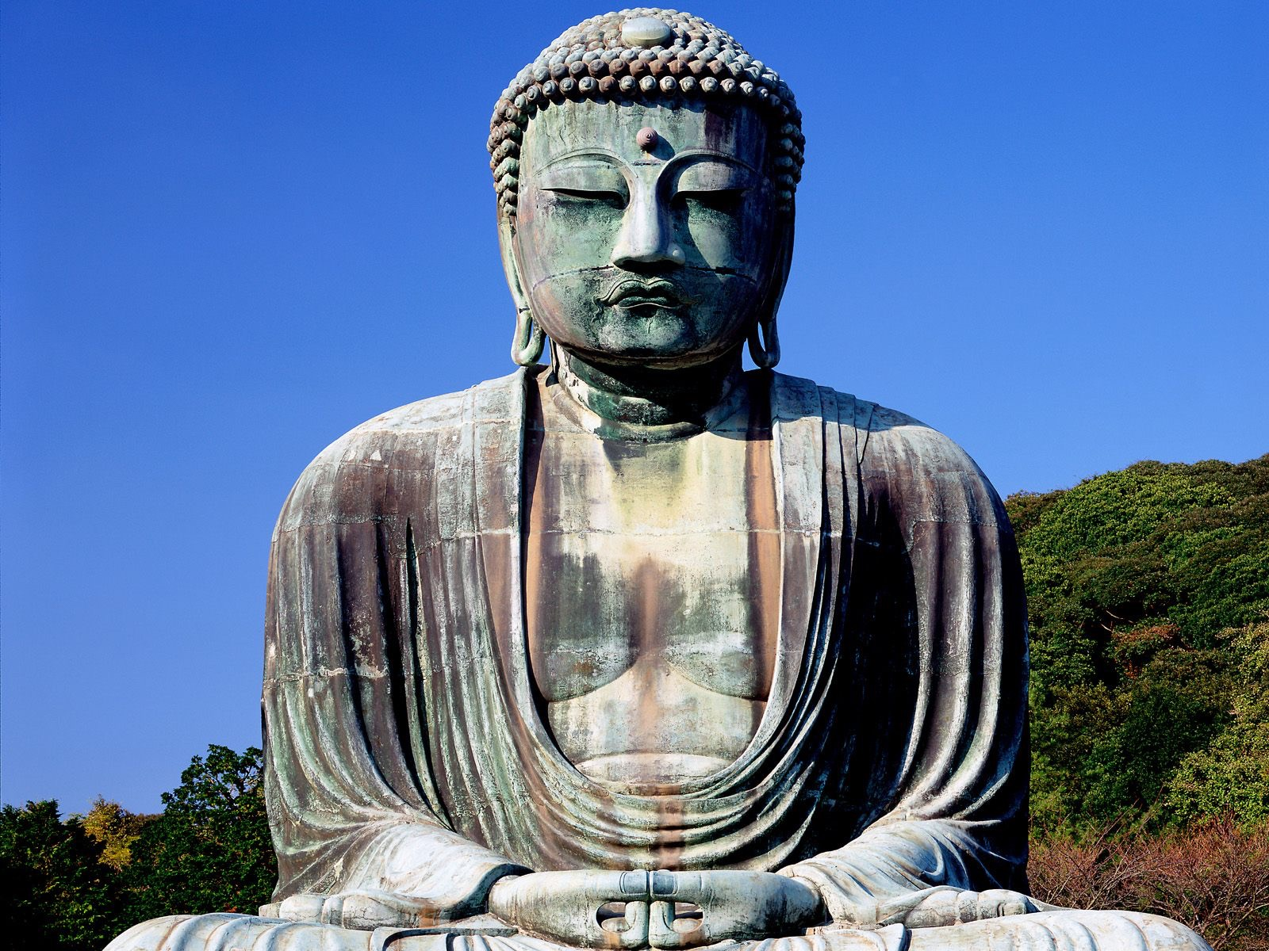
Third eye
Finally Buddha is often shown with a round mark on his forehead which represents his third eye, meaning he could see things that ordinary people could not see.

Slide 15
Challenge!
Your challenge is to draw your own image of Buddha using one of the five mudras and showing all the symbols we have talked about…

