Slide 1
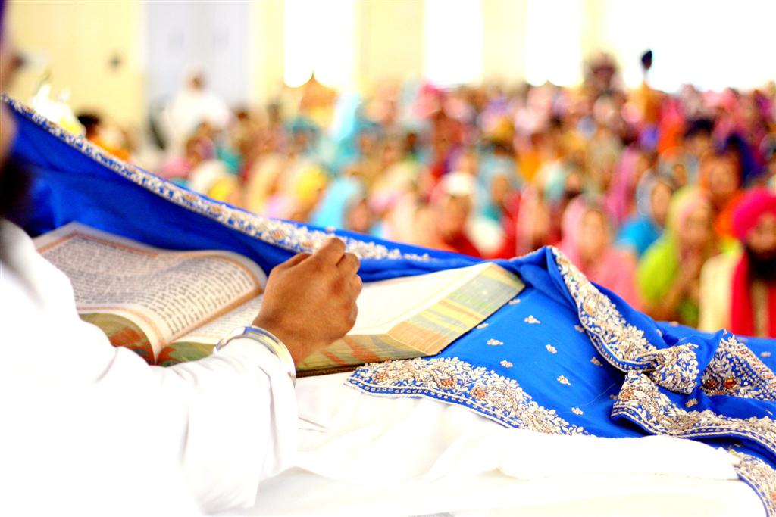
Look out for these other features!
The most important focus in the main hall is the Guru Granth Sahib, which is treated with the respect that would be given to a human Guru. It is kept in a room of its own during the night and then carried to the main hall at the beginning of the day's worship.
The book is placed on a raised platform, under a special canopy, and covered with an expensive cloth when not being used.
Photo courtesy of karamsingh (@flickr.com) - granted under creative commons licence - attribution

Slide 2
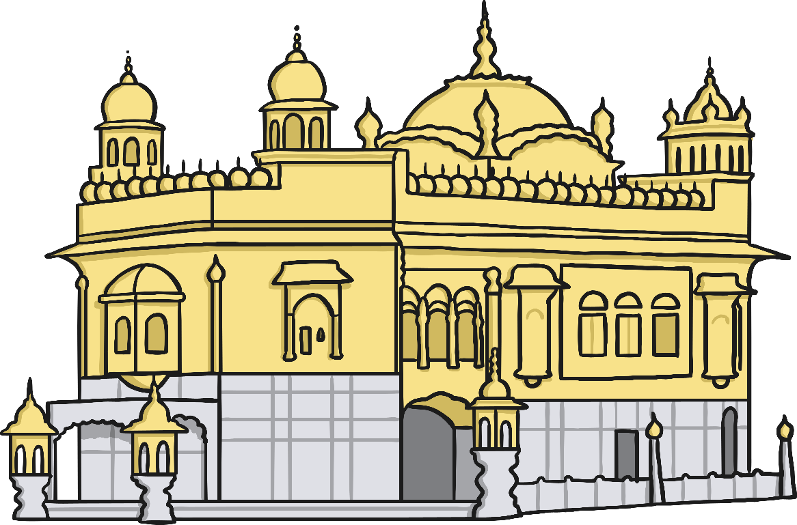
Look out for these other features!
There are four doors into a gurdwara, known as the Door of Peace, the Door of Grace, the Door of Livelihood and the Door of Learning.
These doors are a symbol to everyone that people from all four points of the compass are welcome to enter.
Photo courtesy of karamsingh (@flickr.com) - granted under creative commons licence - attribution

Slide 3
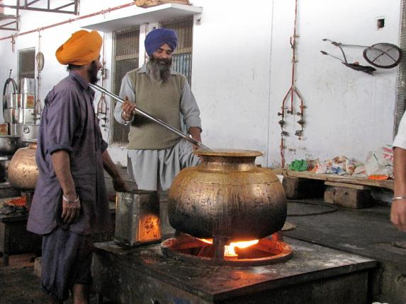
Why do people go to a Sikh gurdwara?
Many Sikhs visit a gurdwara for worship. The gurdwara is also a place to learn more about Sikhism. The gurdwara is a community centre too, offering food, shelter and company for those who need it.
The morning service begins with singing a hymn, there is also a religious talk (called a sermon), prayers are said then there are readings from the Guru Granth Sahib (the holy book). Last of all, food is offered to everyone so people can eat and spend time together.
Photo courtesy of jasleen_kaur (@flickr.com) - granted under creative commons licence - attribution

Slide 4
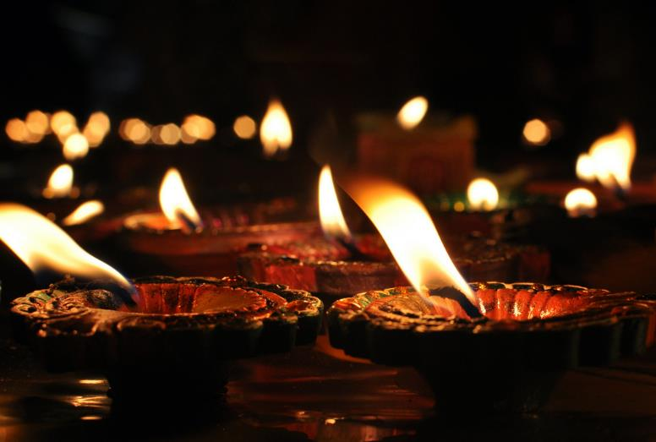
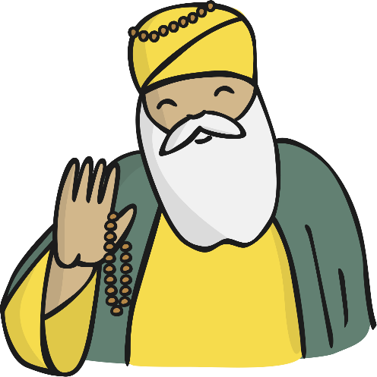
Why do people go to a Sikh gurdwara?
People also visit the gurdwara during special festivals to celebrate Gurus such as Guru Nanak because he started the Sikh faith.
Sikhs don’t have priests so any Sikh can lead the prayers and read from the Guru Granth Sahib.
Photo courtesy of jasleen_kaur (@flickr.com) - granted under creative commons licence - attribution

Slide 5
Why do people go to a Sikh gurdwara?
Sikhs come to the gurdwara to name a new baby.
Watch the video to find out what happens.
http://www.bbc.co.uk/learningzone/clips/the-gurdwara-pt-1-2/4836.html
Source - bbc.co.uk/learningzone - © 2014 BBC

Slide 6
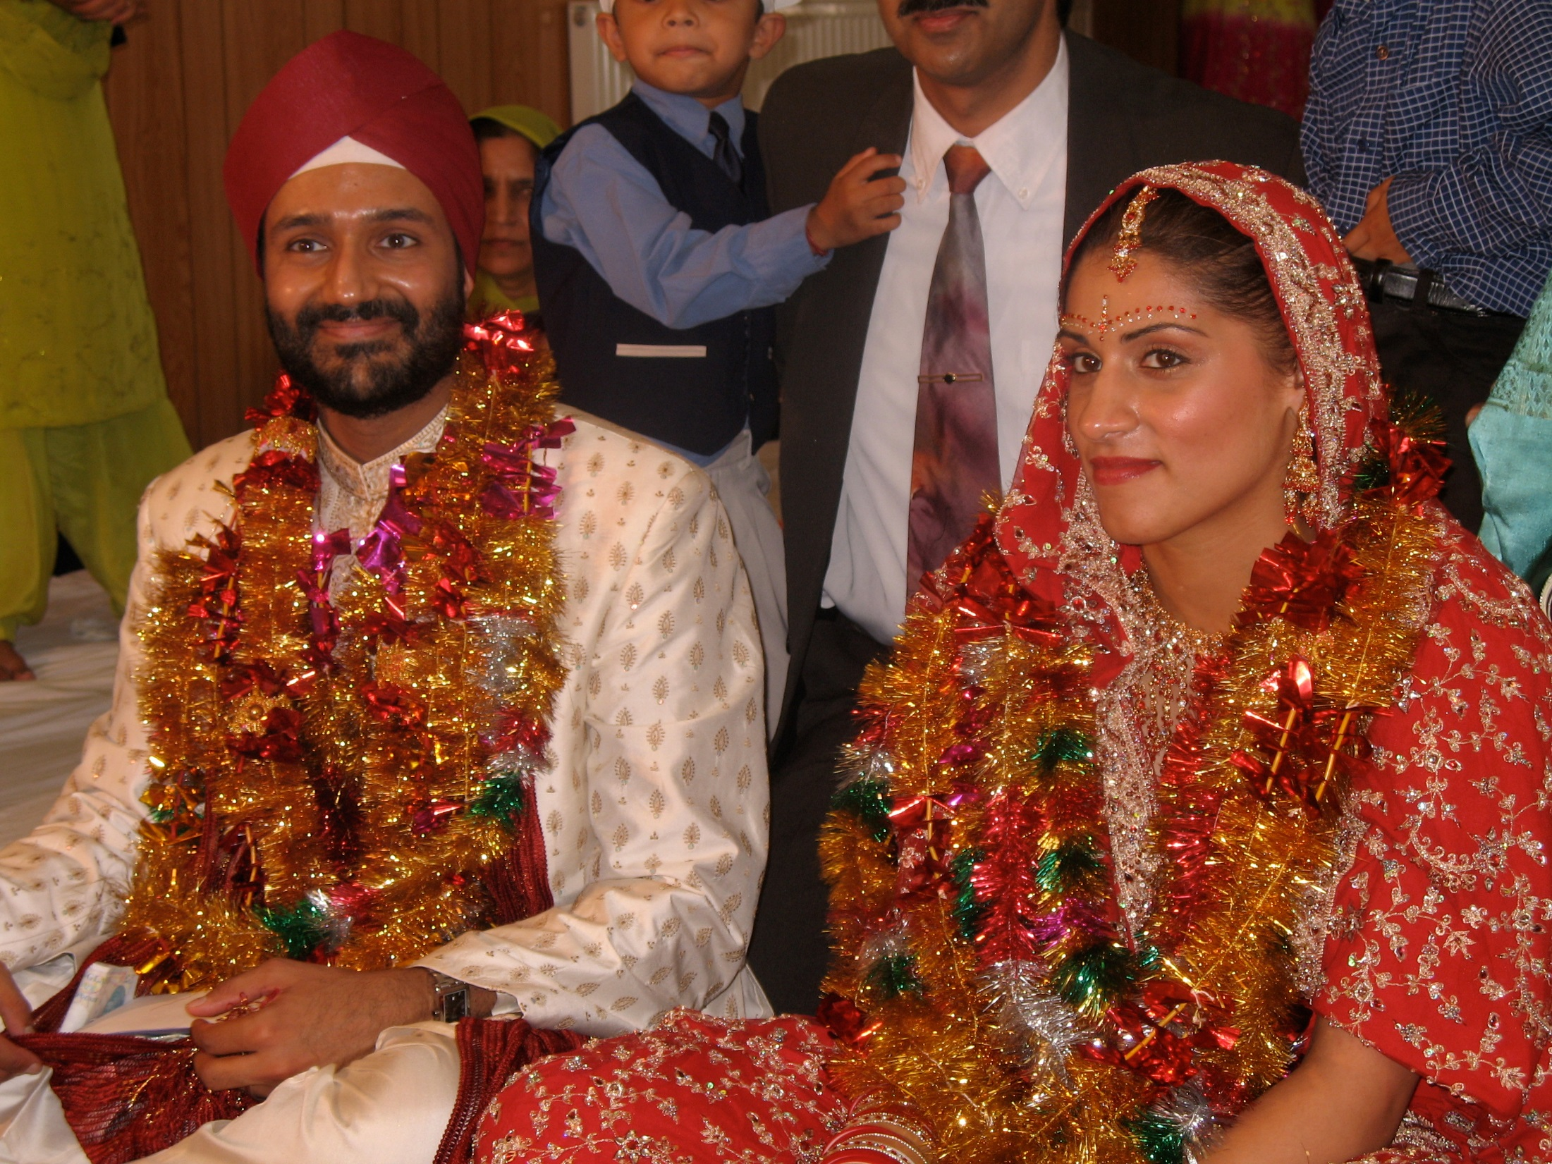
Engagement ceremonies can take place at the gurdwara and thanks is given for bringing the man and the woman together.
The wedding ceremony takes place in front of the Guru Granth Sahib and at the end of the service, everyone eats in the langar.
Photo courtesy of Jon Evans (@flickr.com) - granted under creative commons licence - attribution

Slide 7


Showing Respect
Anyone is welcome in a gurdwara but there are certain rules to follow.
Cover your head
Take off your shoes and wash hands and feet before entering
When you enter the main prayer hall, bow in front of the holy book,
touching the floor with your forehead

Slide 8
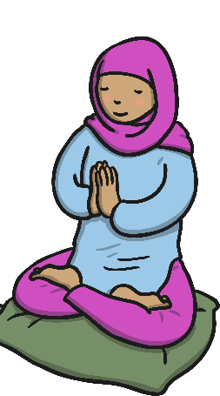
Showing Respect
Offer a donation such as money, flowers or food
Sit quietly on the floor with your legs crossed, facing the Guru Granth Sahib
Never point your feet at the Guru Granth Sahib as this is disrespectful
Men and women sit in different places

Slide 9
Plenary
Why do you think it is important to many Sikhs to worship and eat
together in the gurdwara?
Do you have any other questions about this place of worship?

