Slide 2
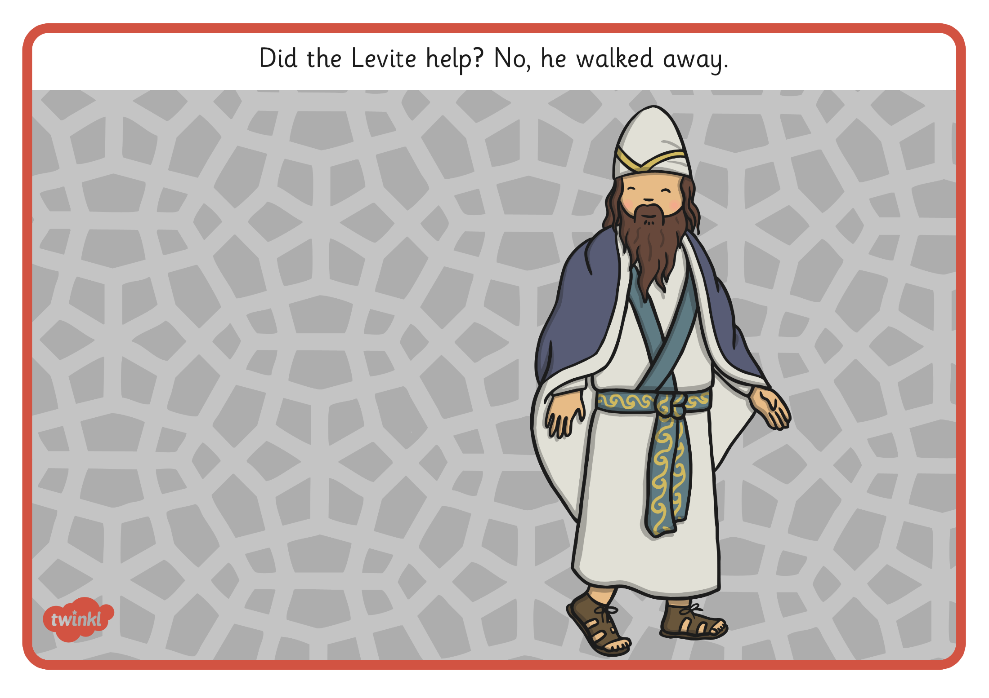
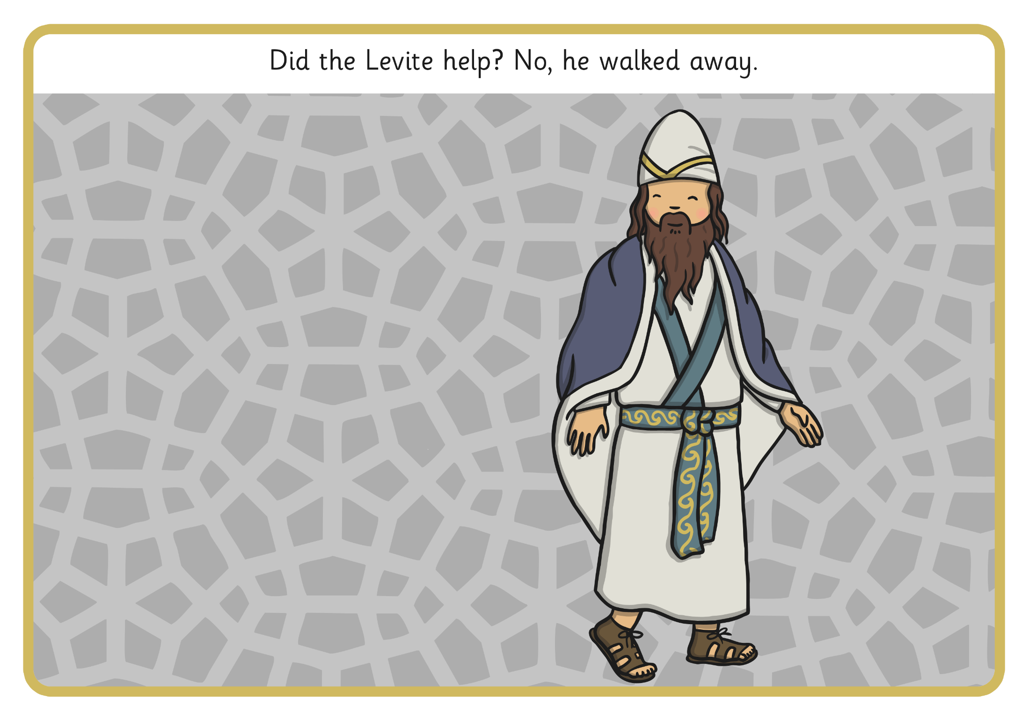
Did the Levite help? No, He walked away.

Slide 3
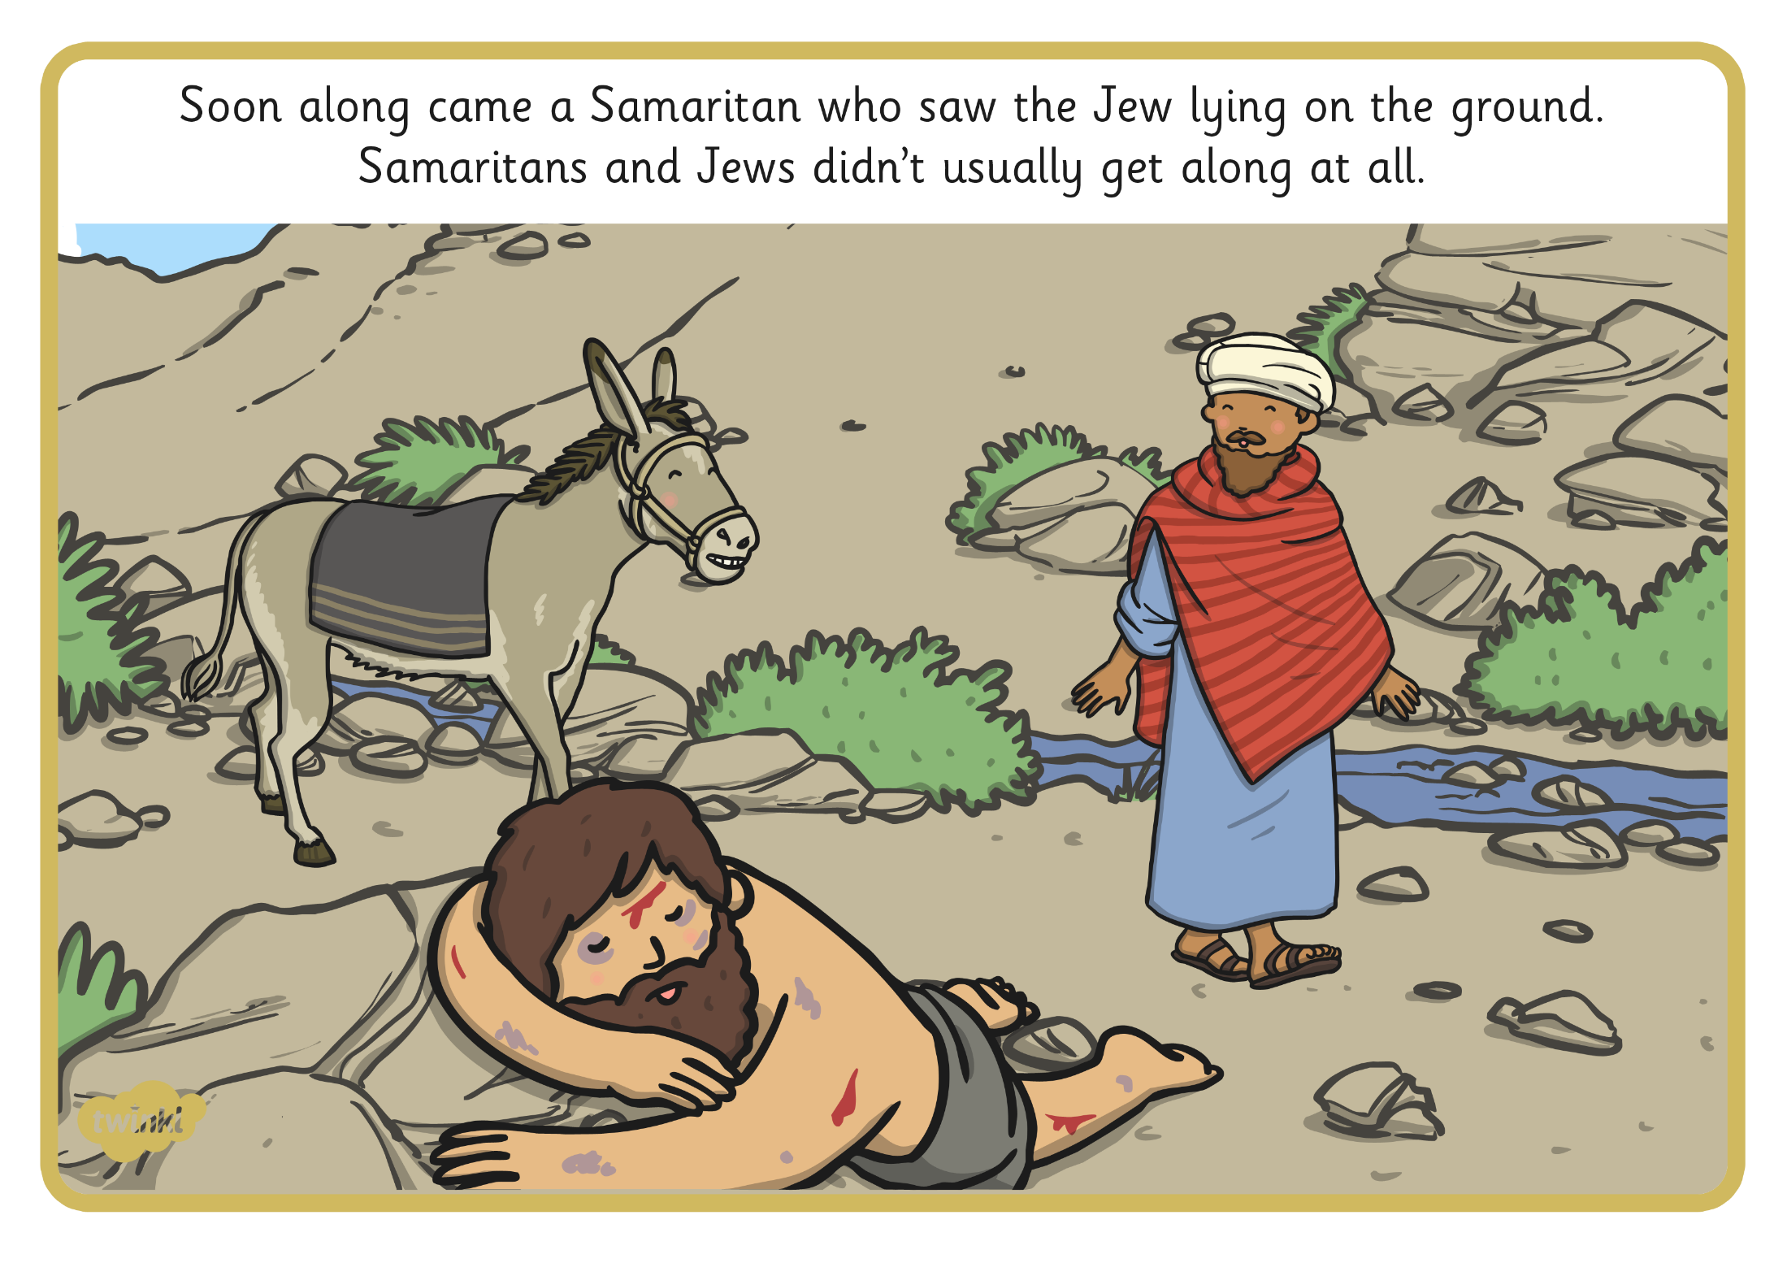
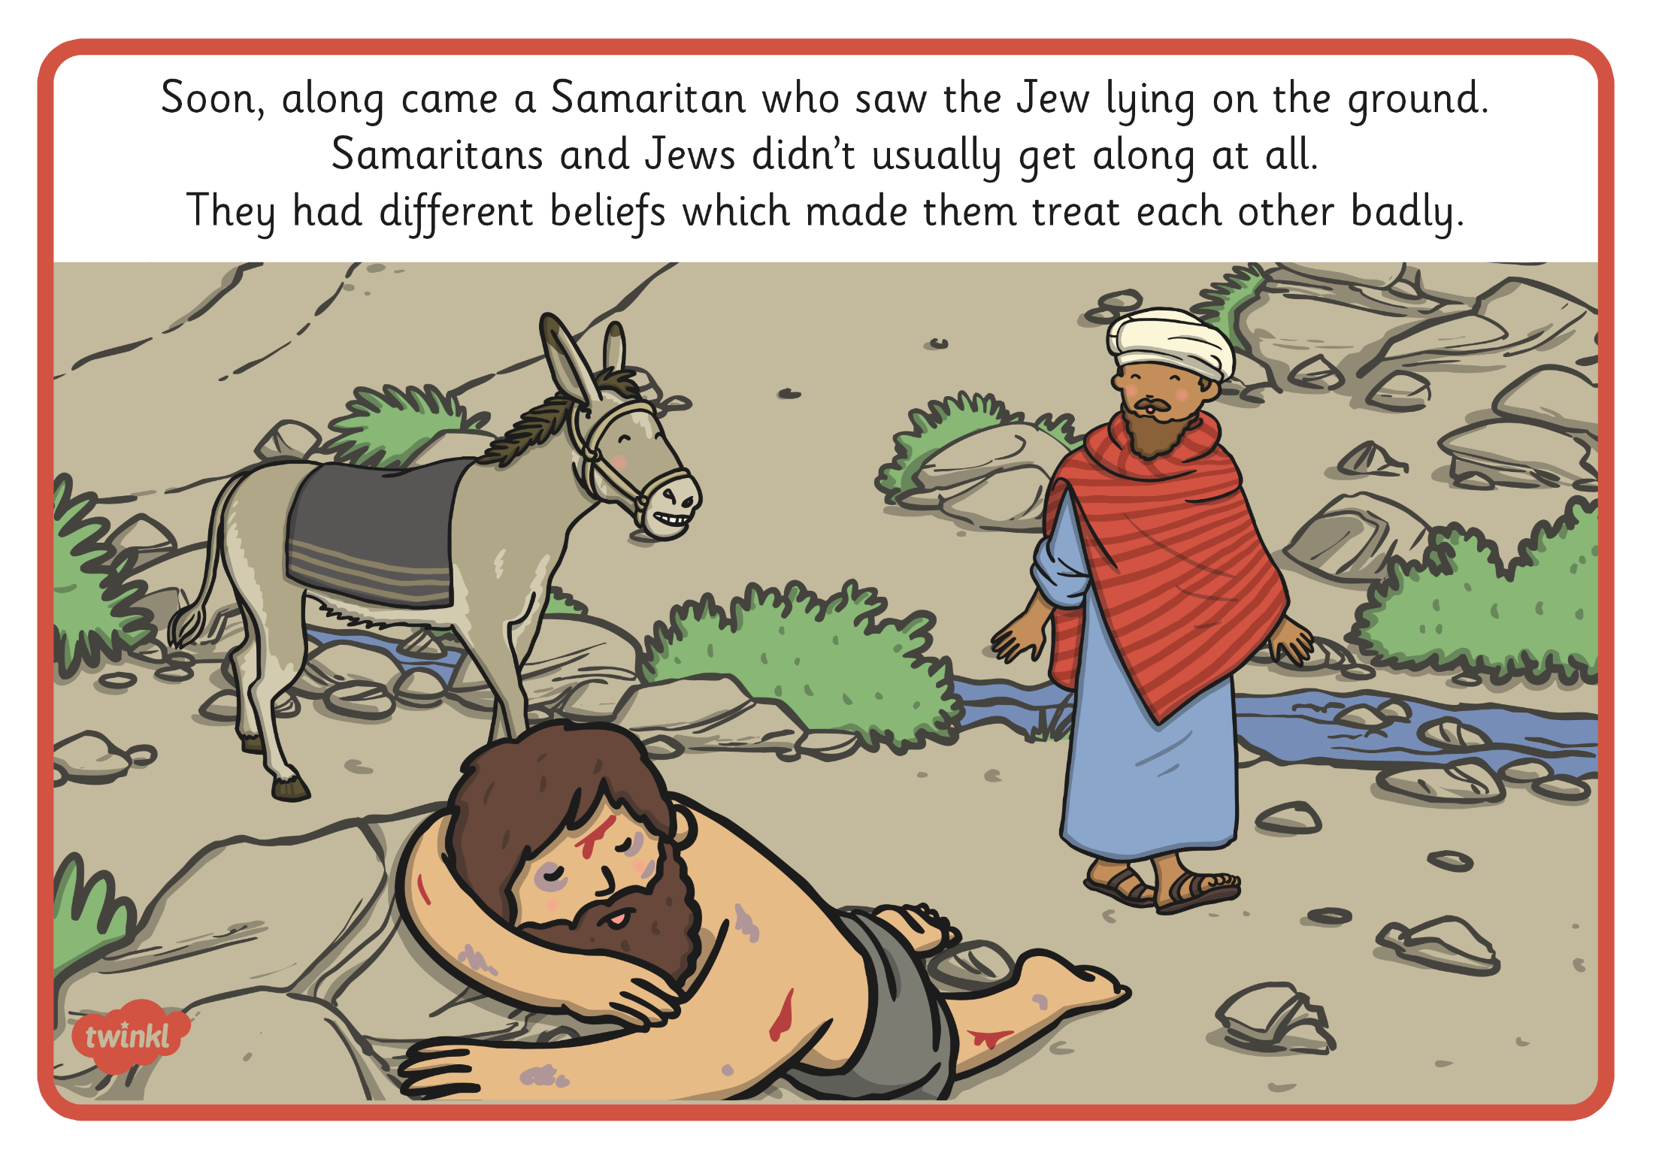
Soon, along came a Samaritan who saw the Jew lying on the ground. Samaritans and Jews don’t usually get along at all. They had very different beliefs which made them treat each other badly.

Slide 4
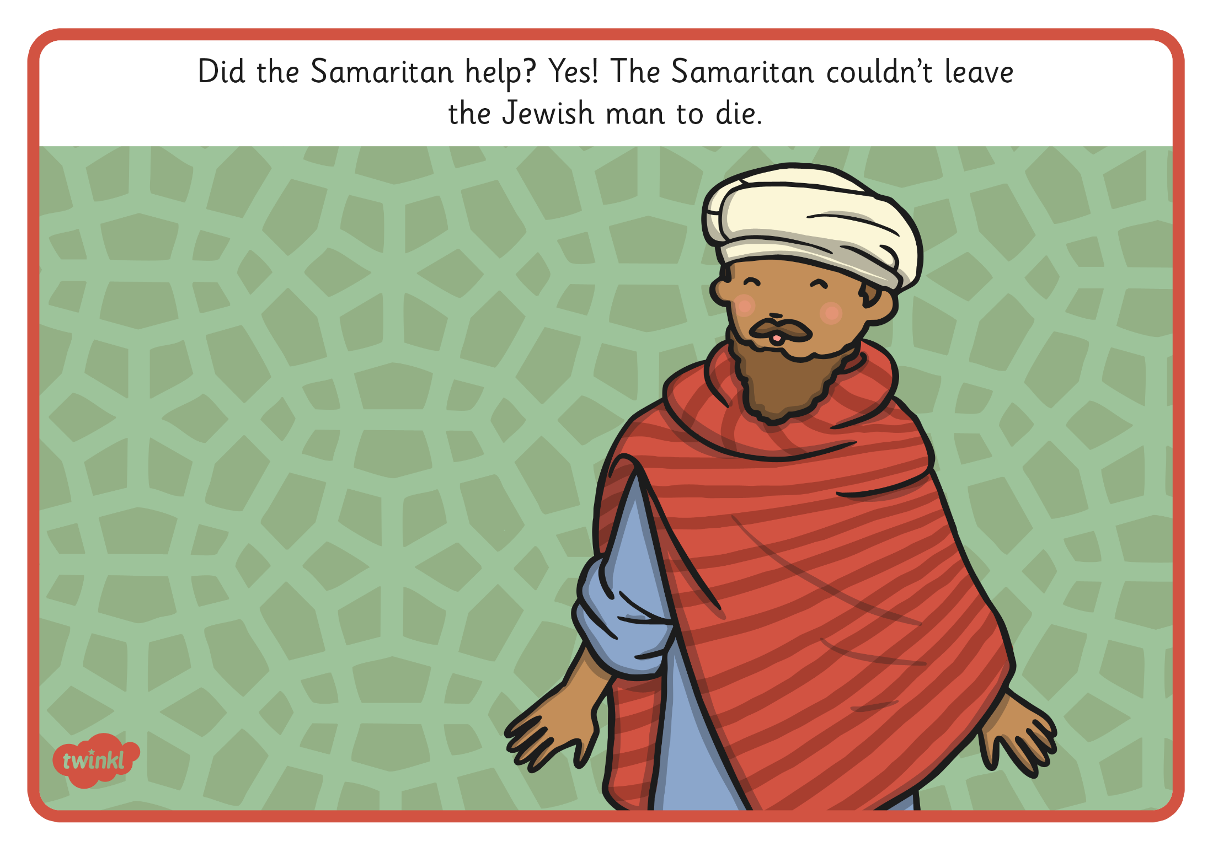
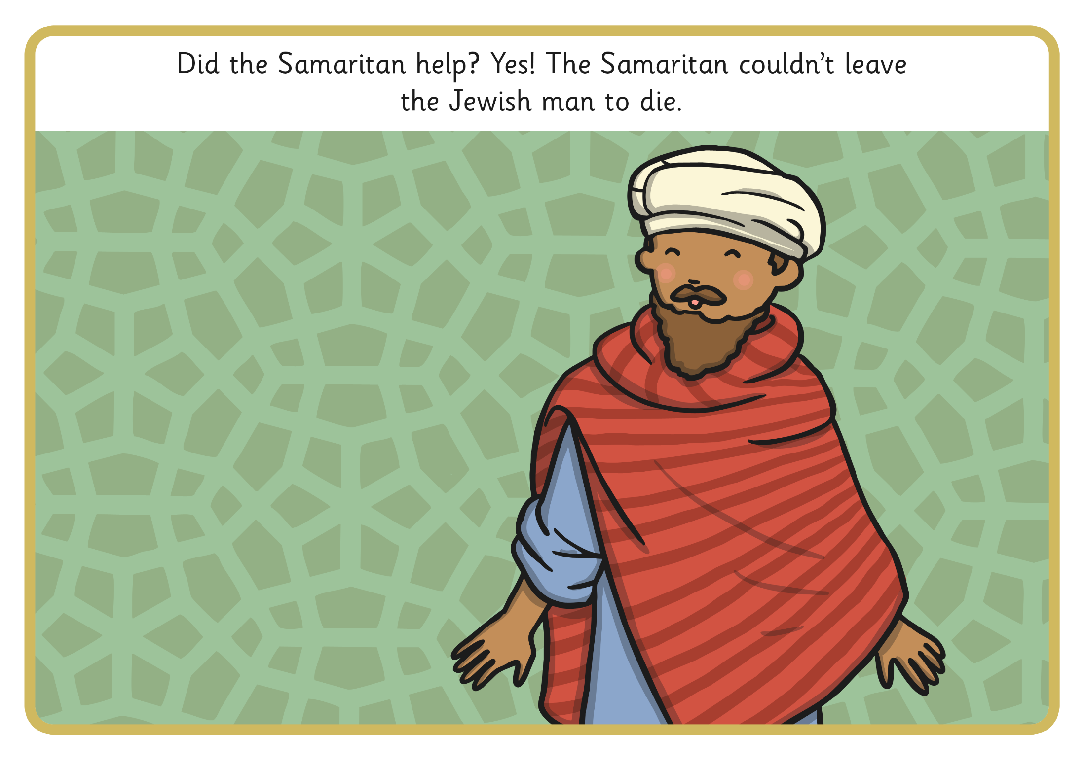
Did the Samaritan help? Yes! The Samaritan couldn’t leave the Jewish man to die.

Slide 5
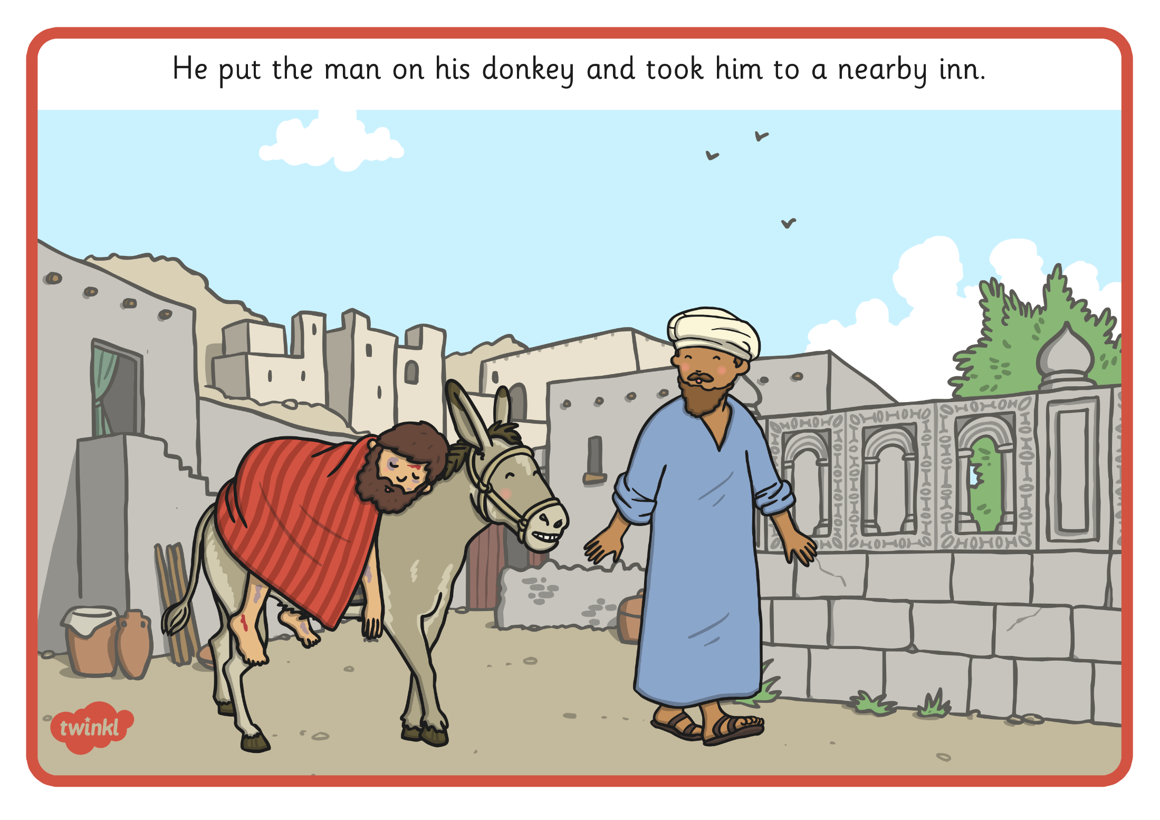
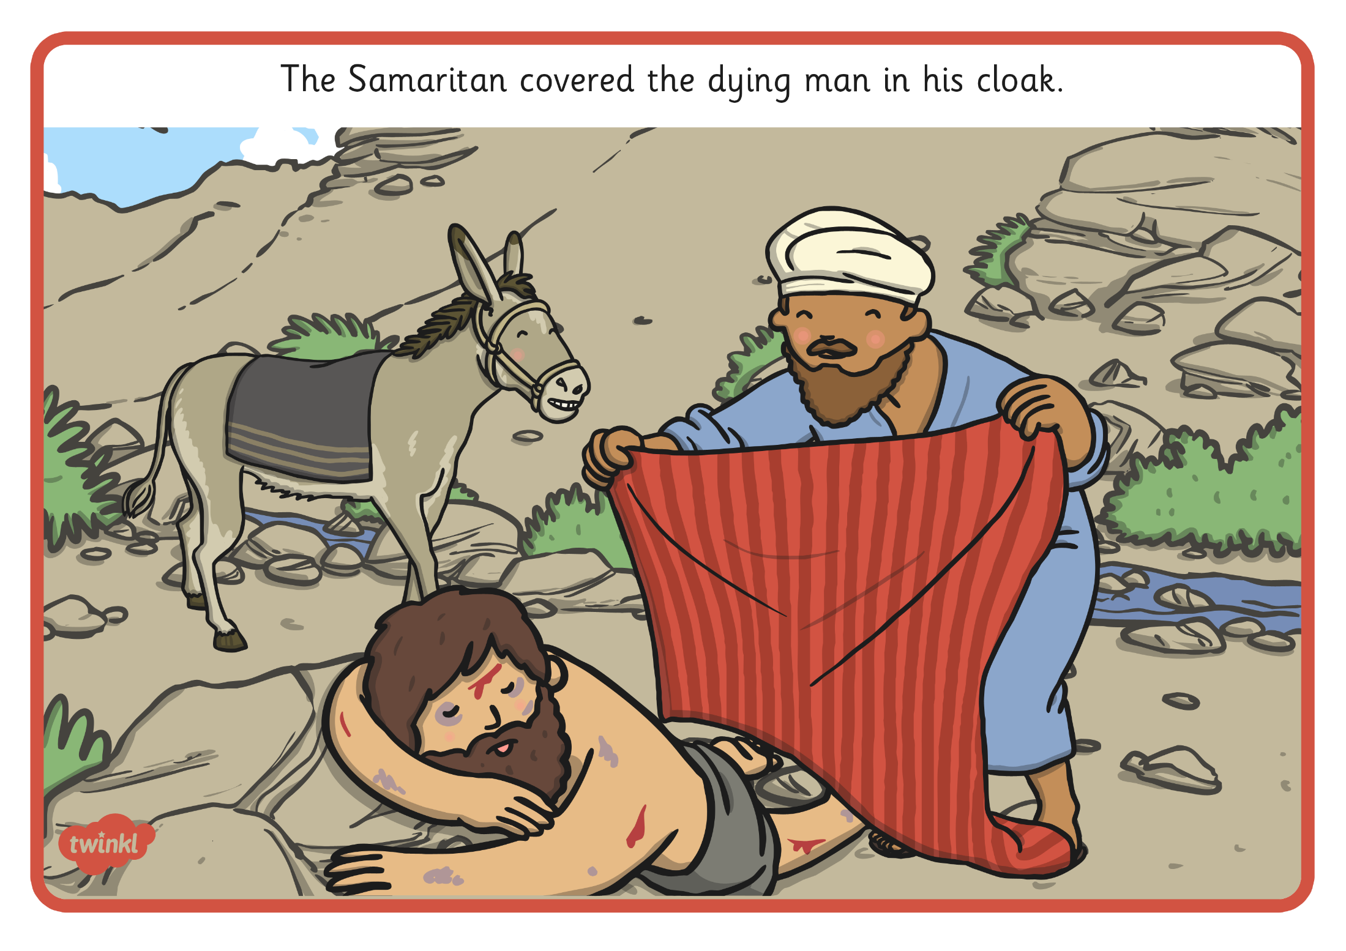
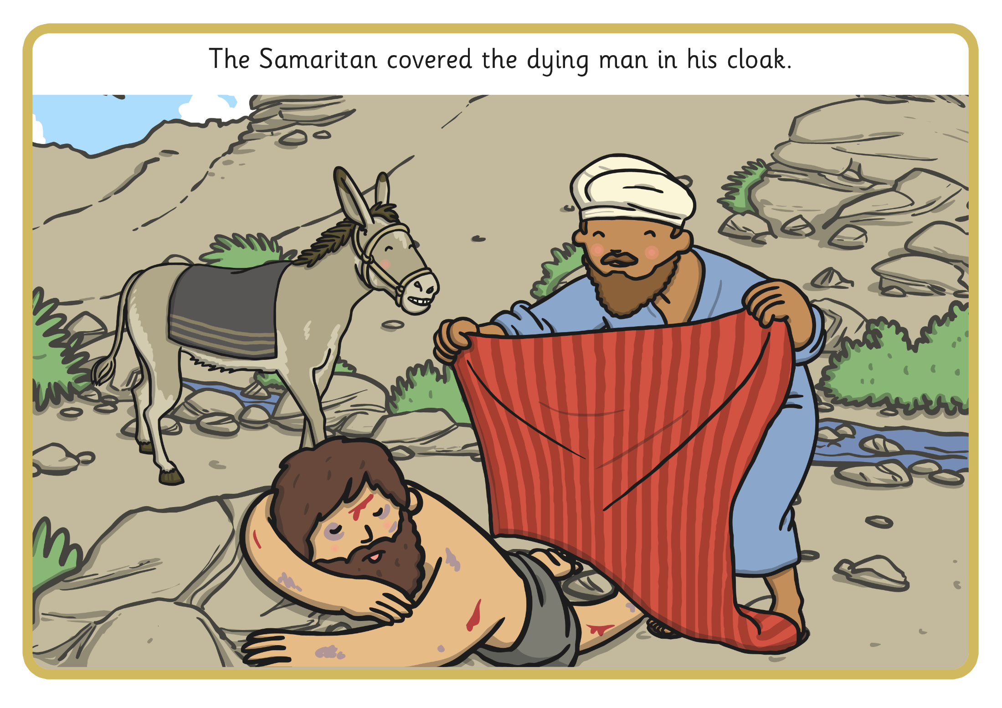
The Samaritan covered the dying man in his cloak.

Slide 6
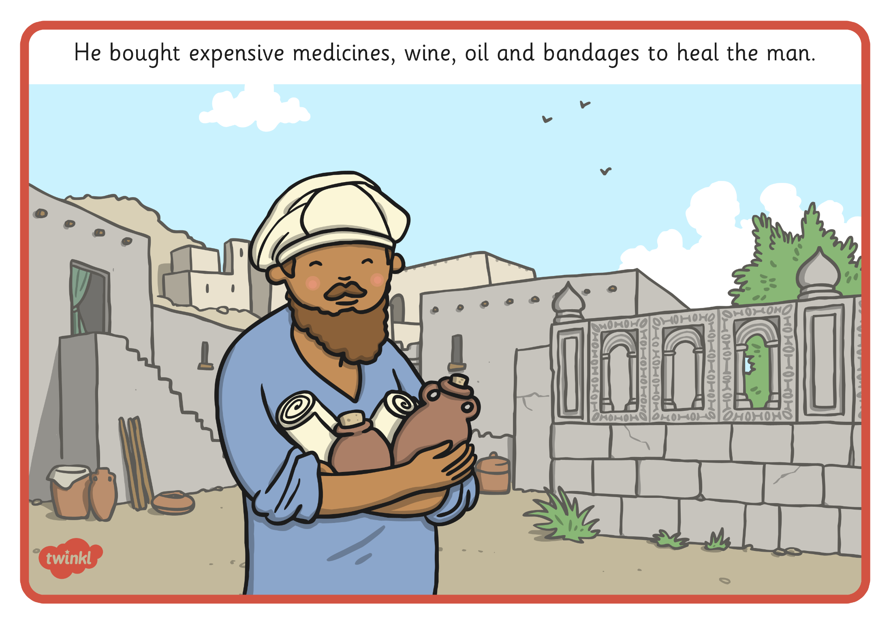
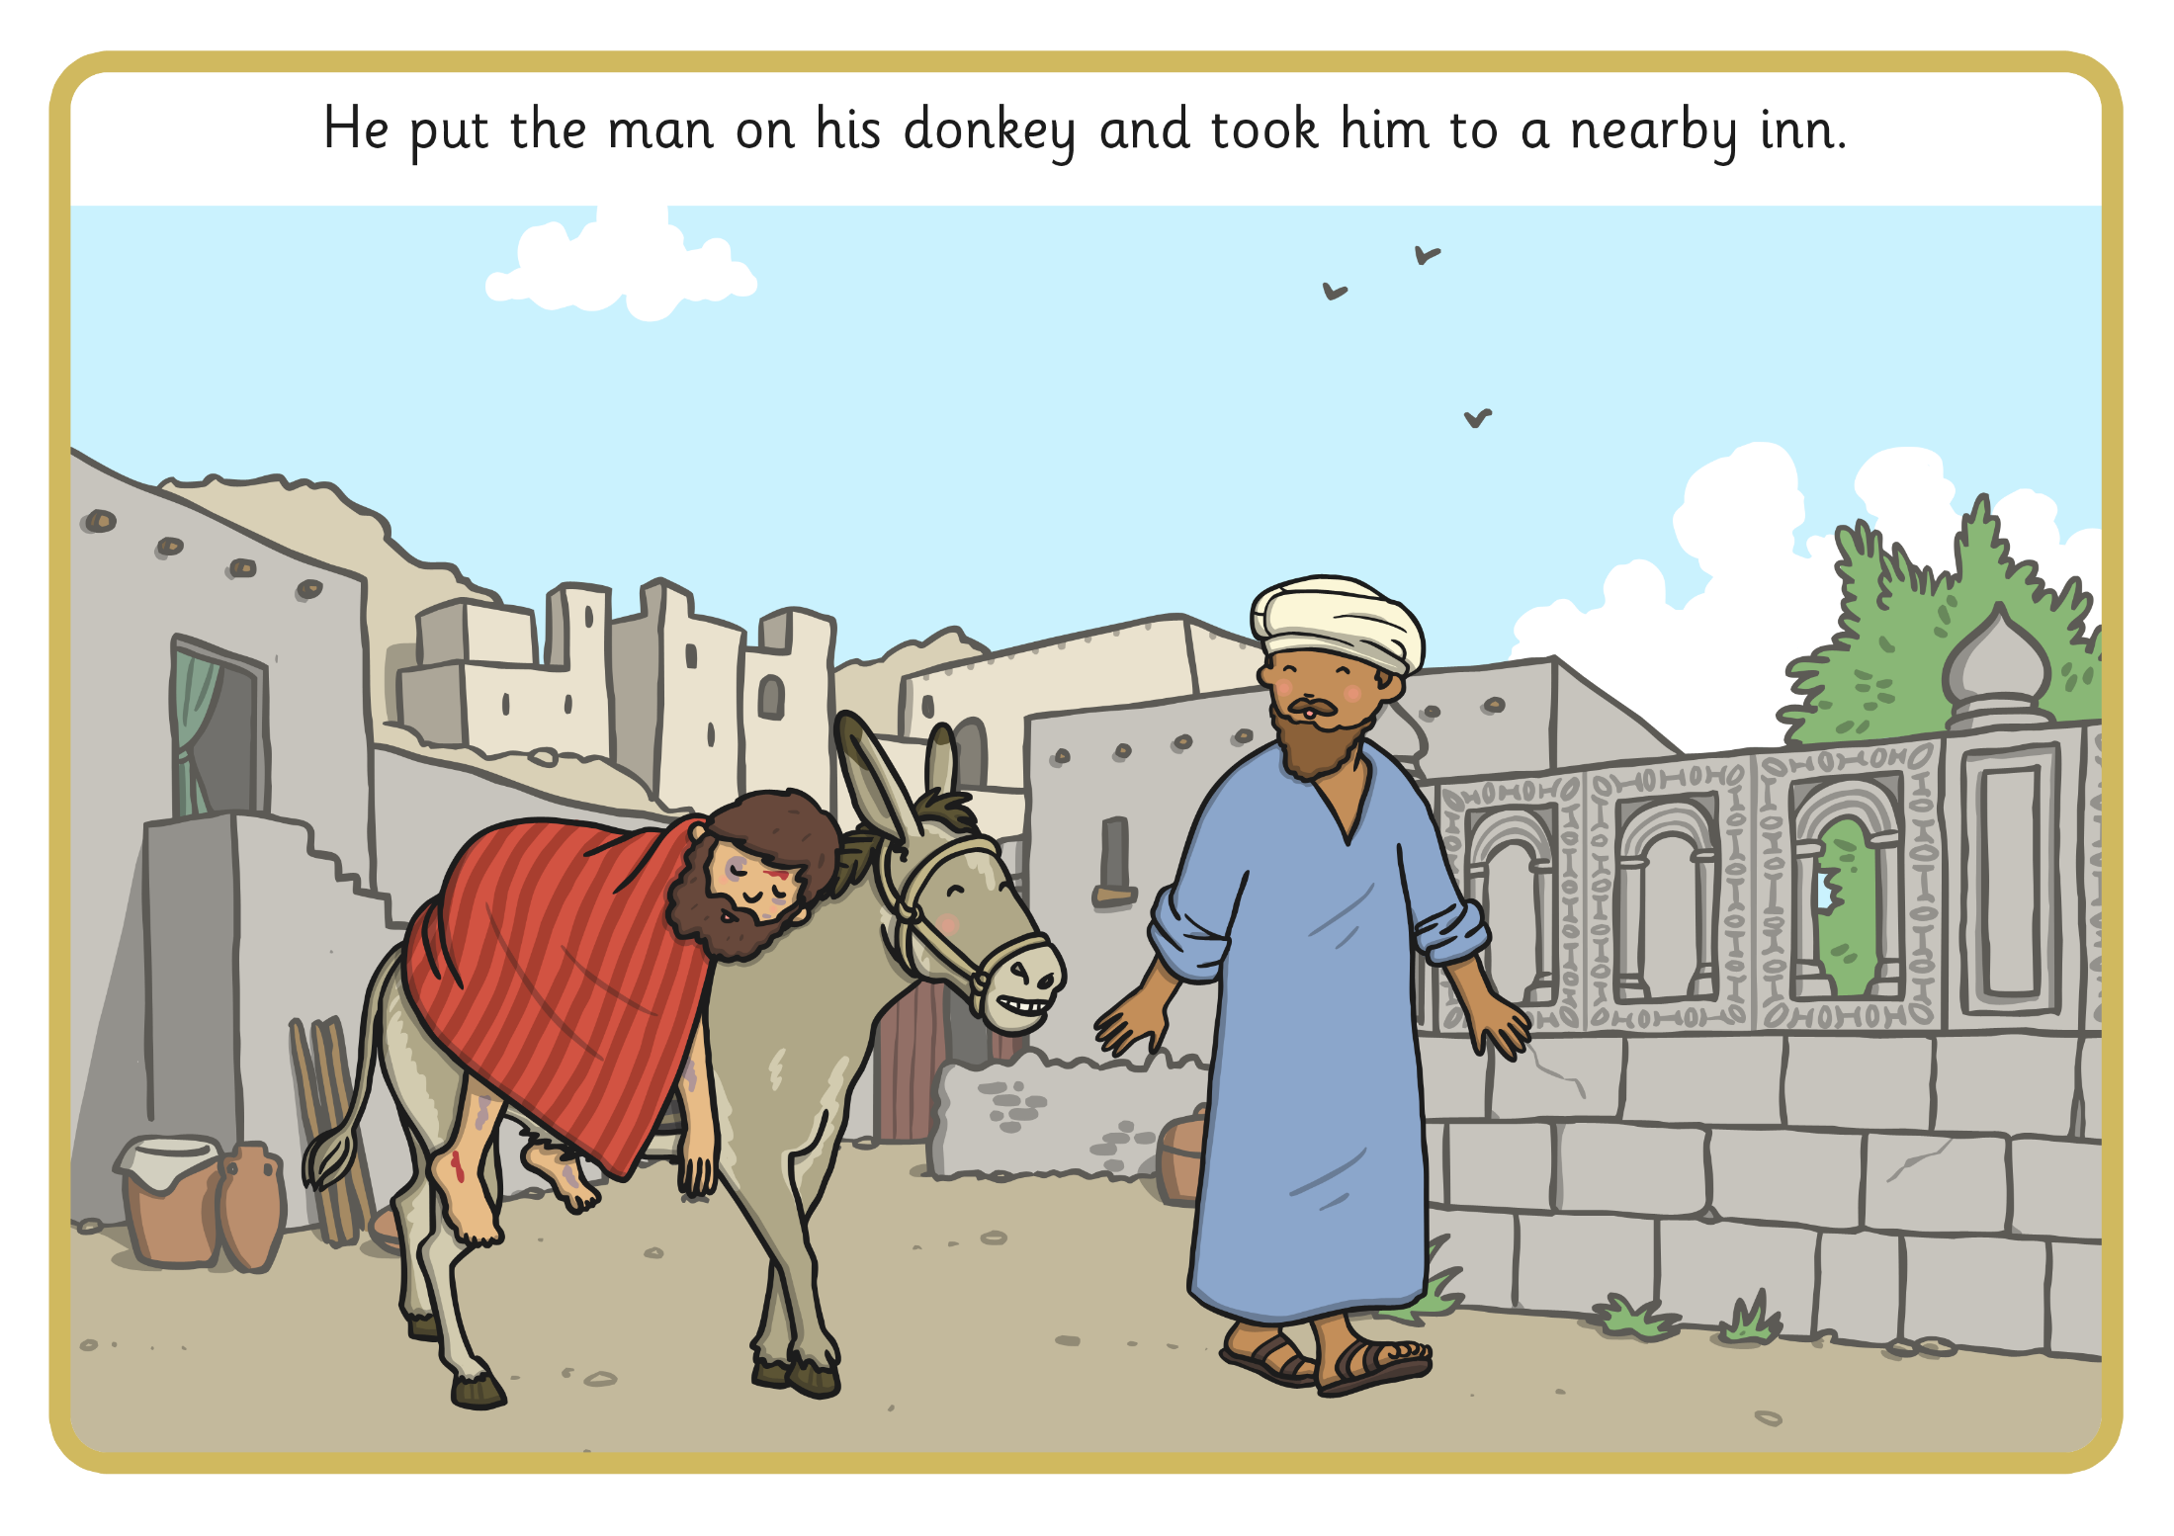
He put the man on his donkey and took him to a nearby inn.

Slide 7
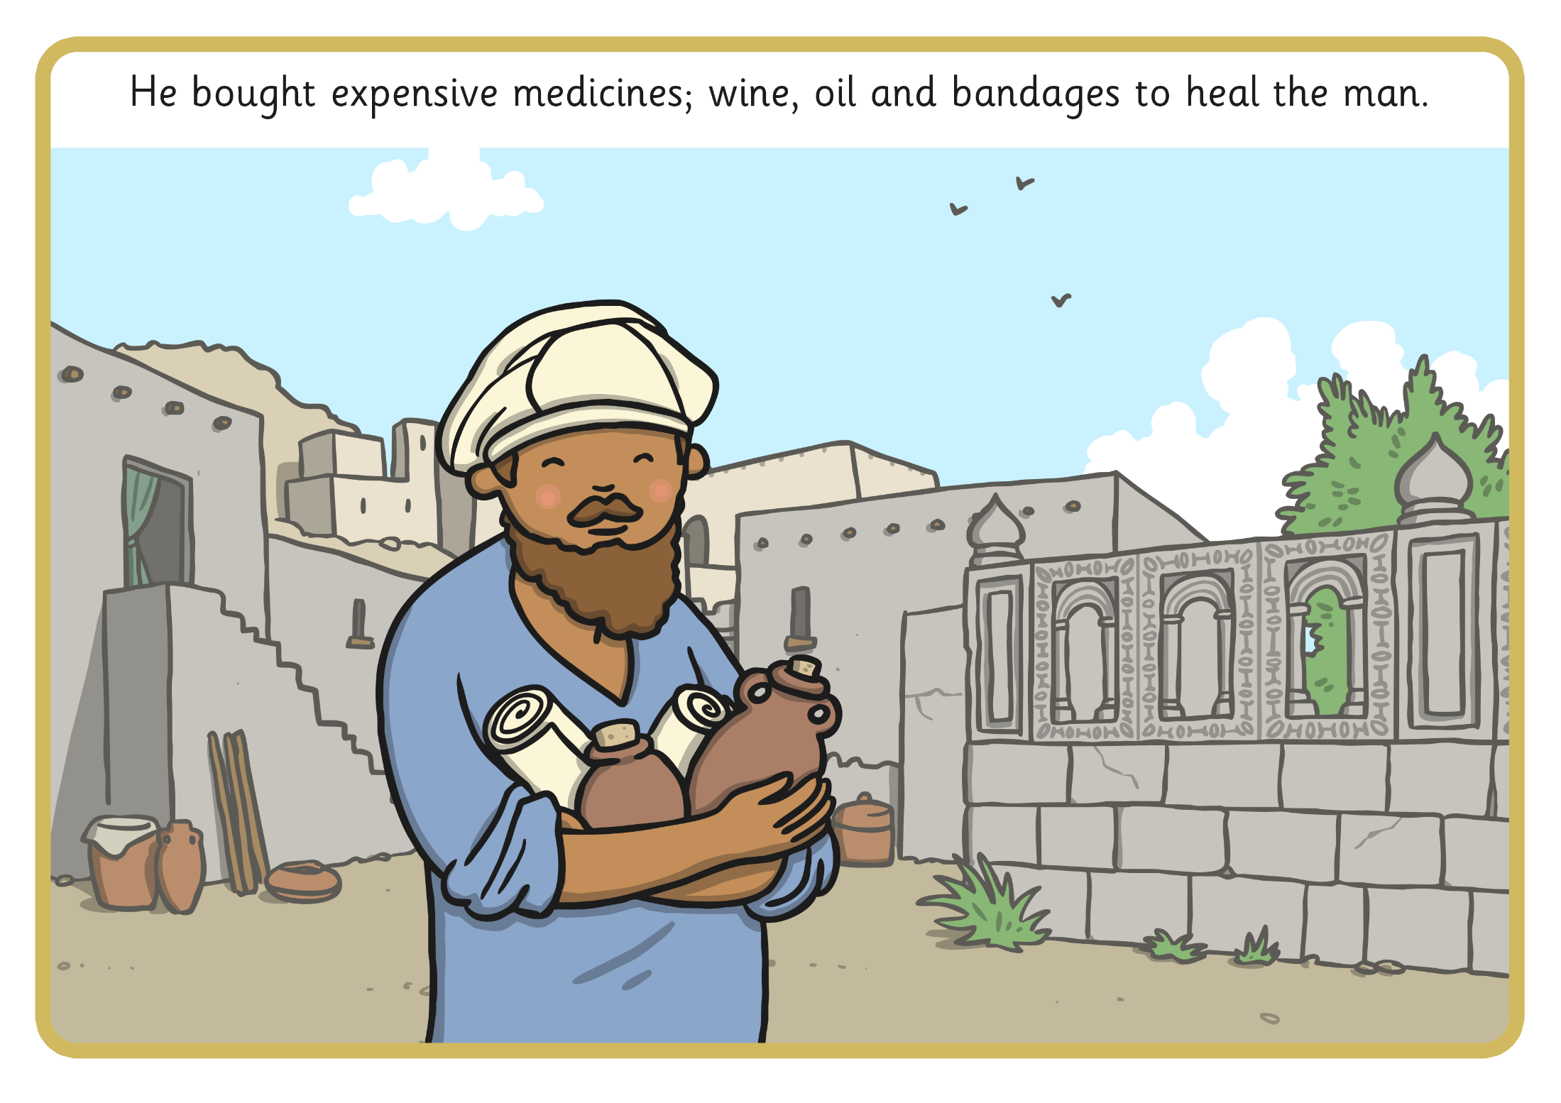
He bought expensive medicine, wine, oil, and bandages to heal the man.
He bought expensive wine, oil and bandages to heal the man.

Slide 8
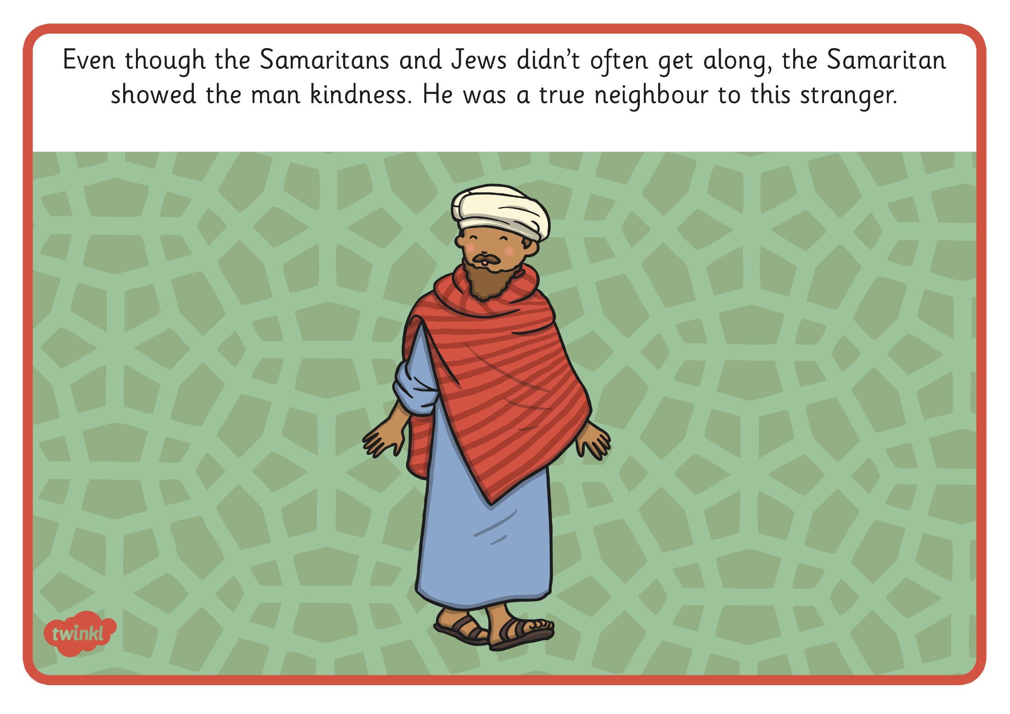
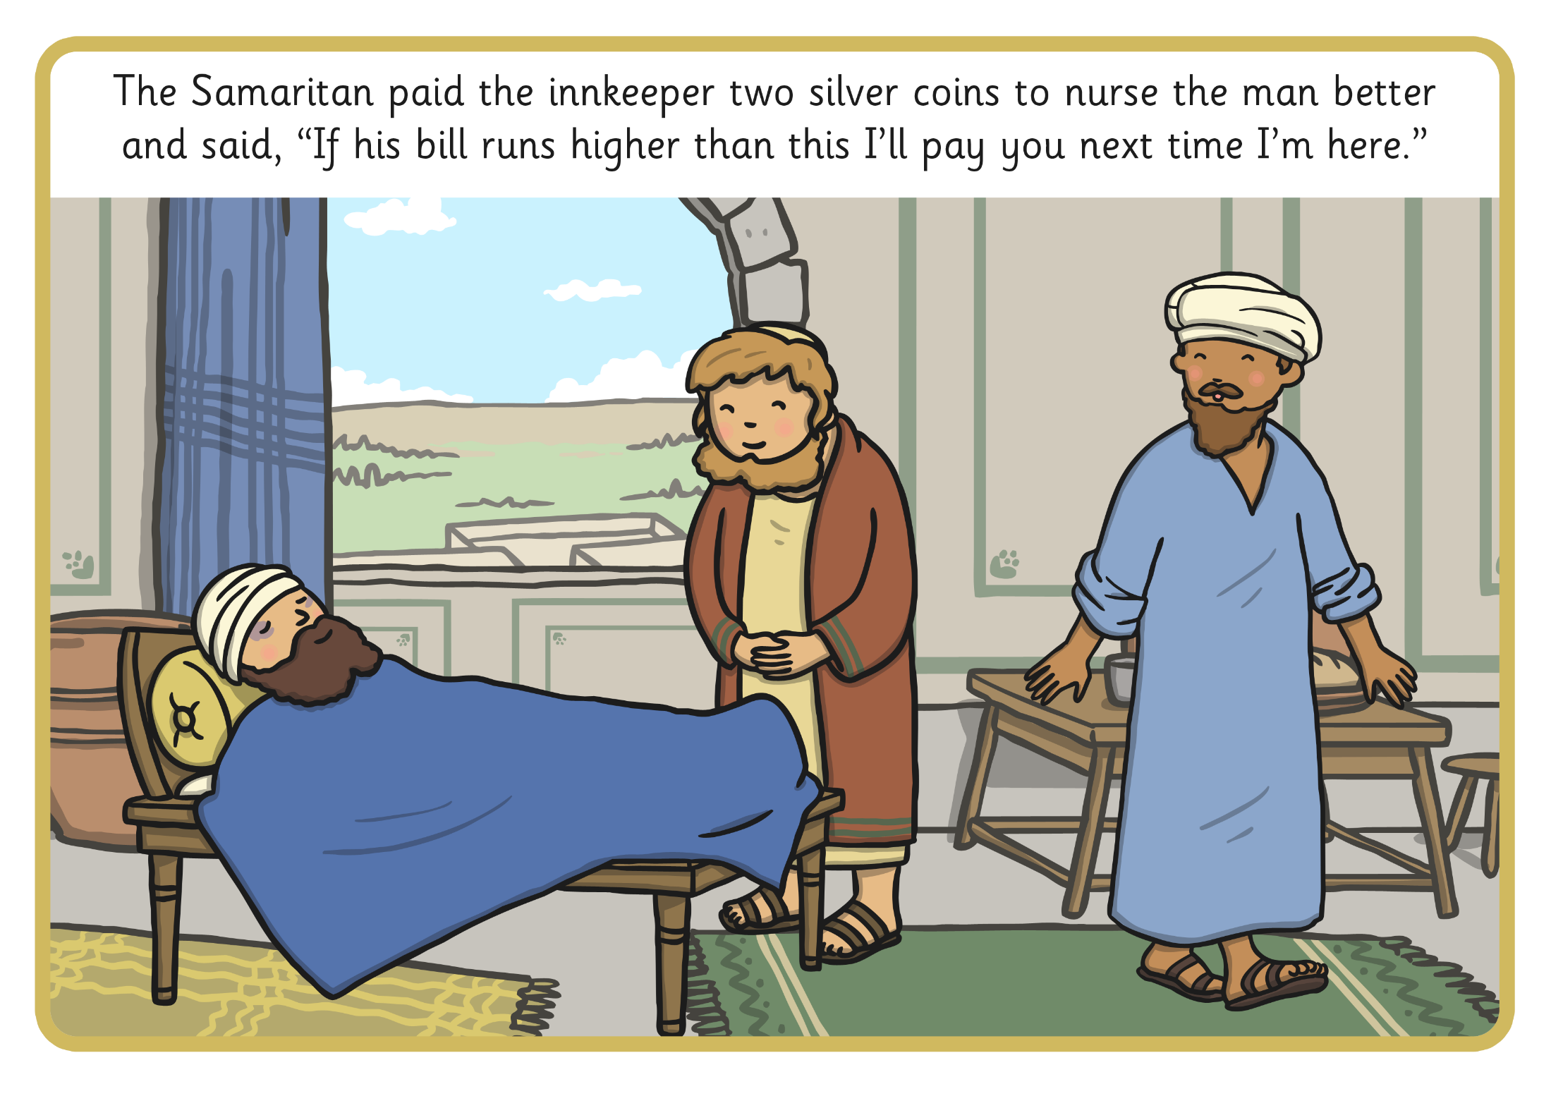
Even though the Samaritans and Jews didn’t often get along,
the Samaritan showed the man kindness.
He was a true neighbour to this stranger.

