Slide 1
Unicef/Dejongh
Notes:
U-Reporters in Daloa, in the West of Côte d'Ivoire.
Unicef/Dejongh

Slide 2
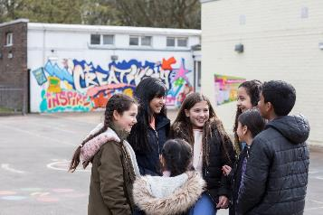
Guess the article
These pictures provide a clue to this week’s article. All these pictures were all taken before social distancing measures were put in place.
What rights is being shown in these pictures? Can you guess how they are linked together?
Write down your thoughts or discuss with someone in your home.
UNICEF/Pawelczyk
UNICEF/Herwig
Unicef/Dawe

Slide 3

Introducing… Article 15
Stuart introduces Article 15
Article 15 – Freedom of association
Every child has the right to meet with other children and to join groups and organisations, as long as this does not stop other people from enjoying their rights.
Watch Stuart in YouTube

Slide 4
Exploring Article 15
What is needed for you to enjoy the right to get together and join up with other children and young people?
Write them down and then compare your answers with the next slide.

Slide 5
How many of these did you get?
Clubs, organisations and groups that are near to you or can be accessed safely.
Groups and organisations that have fun and appropriate activities.
Safe places to meet.
Choice of clubs in school.
Encouragement from parents and carers to get involved.
Activities to join in with that do not disrupt the rights of others.
Freedom to start a group if there is something you feel strongly about.
Clubs and organisations should not be too expensive to join.
Any other ideas…

